Slide 1
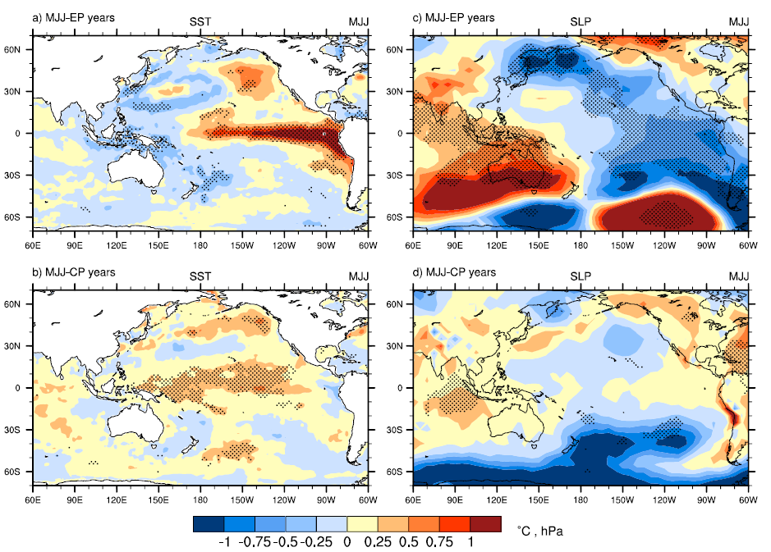
The role of the Southern Hemisphere semiannual oscillation (SAO) as a precursor to the development of different types of El Niño events
Objective: Document the contribution of the seasonal cycle, represented by the semiannual oscillation (SAO) in the Australia-Pacific region, to the development of El Niño events in either the eastern equatorial Pacific or central equatorial Pacific
Research:
--Analyze observations of sea surface temperature, sea level pressure, and upper ocean temperatures
--document the connection of the SAO in the May-June-July (MJJ) season, when the circumpolar trough is farthest north and can best interact with the tropics, to subsequent El Niño development
a) Composite observed May-June-July (MJJ) SST anomalies, eastern Pacific El Niño years (MJJ-EP) minus climo (1951–2010); stippling indicates significance at the 95% level; largest warming is in the equatorial eastern Pacific; b) Same as in (a) except for central Pacific El Niño (MJJ-CP) years with greatest warming in the central equatorial Pacific; c) Same as (a) except for MJJ-EP sea level pressure (SLP) anomalies showing largest negative SLP anomalies near 30°S in the Pacific (strong SAO) associated with greatest positive SST anomalies in the eastern equatorial Pacific in (a); d) Same as (c) except for central Pacific El Niño years, with largest negative SLP anomalies near 40°S in the Pacific (weak SAO) associated with greatest positive SST anomalies in the central equatorial Pacific in (b).
Impact: A strong SAO, with an anomalously northward-expanded trough of low pressure in MJJ, produces an eastern Pacific El Niño event, while a weak SAO produces a central Pacific El Niño event
Meehl, G.A., H. van Loon, and Julie M. Arblaster, 2017: The role of the Southern Hemisphere semiannual oscillation in the development of a precursor to central and eastern Pacific Southern Oscillation warm events, Geophys. Res. Lett., 44, doi:10.1002/2017GL073832.

