Slide 1
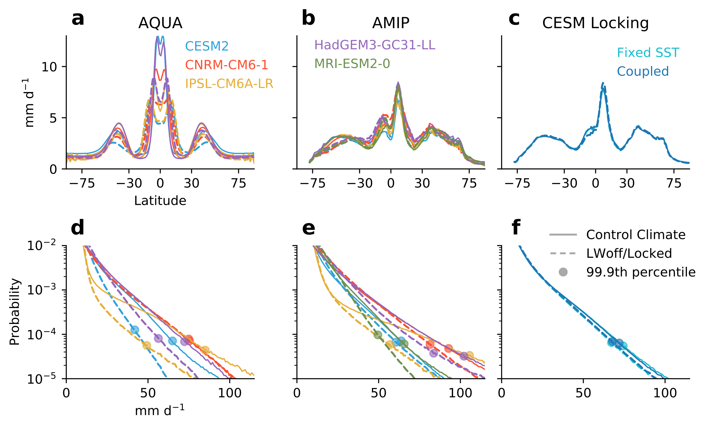
Investigating the impact of cloud radiative feedbacks on tropical precipitation extremes
B. Medeiros, A. C. Clement, J. J. Benedict, B. Zhang npj Climate and Atmospheric Science, https://doi.org/10.1038/s41612-021-00174-x
Objective
Demonstrate a causal link between cloud radiative effects and extreme precipitation over the tropical oceans in climate models.
Approach
Use a hierarchy of model configurations and methods from CMIP6 and CESM2.
CMIP6 aquaplanet and AMIP experiments with clouds made transparent in the longwave remove the coupling between clouds and circulation.
Cloud-locking experiments in CESM2 decouple clouds and circulation while maintaining the mean climate, allowing coupled experiments.
Examine the extreme precipitation, especially over the oceans to discern the impact of cloud radiative effects.
Introduce a new metric, the extreme precipitation fraction, defined as the fraction of precipitation that falls at rates greater than the 95th percentile
Investigate the role of organized convection using tropical wave decomposition and extreme precipitation event detection/tracking.
Impact
The first study that links cloud radiative effects to extreme precipitation in climate models. There is a robust connection whereby cloud radiative effects increase extreme precipitation in all models in all configurations.
Evidence is presented that the connection is through the influence of cloud radiative feedbacks helping to promote organized convection.
Shows that errors in representing clouds impact not only climate sensitivity but hydrologic extremes.
Indicates that representing both cloud radiative properties and organized convection are crucial for increasing confidence in climate prediction.
Simulated precipitation distributions. (upper) Zonal average precipitation and (lower) histogram of tropical marine precipitation for (left-to-right) aquaplanet experiments, AMIP experiments, and CESM2 cloud-locking experiments. Colors are as noted in legends, with solid curves showing the control simulations and dashed curves showing the LWoff or cloud-locked simulations.

