Slide 1
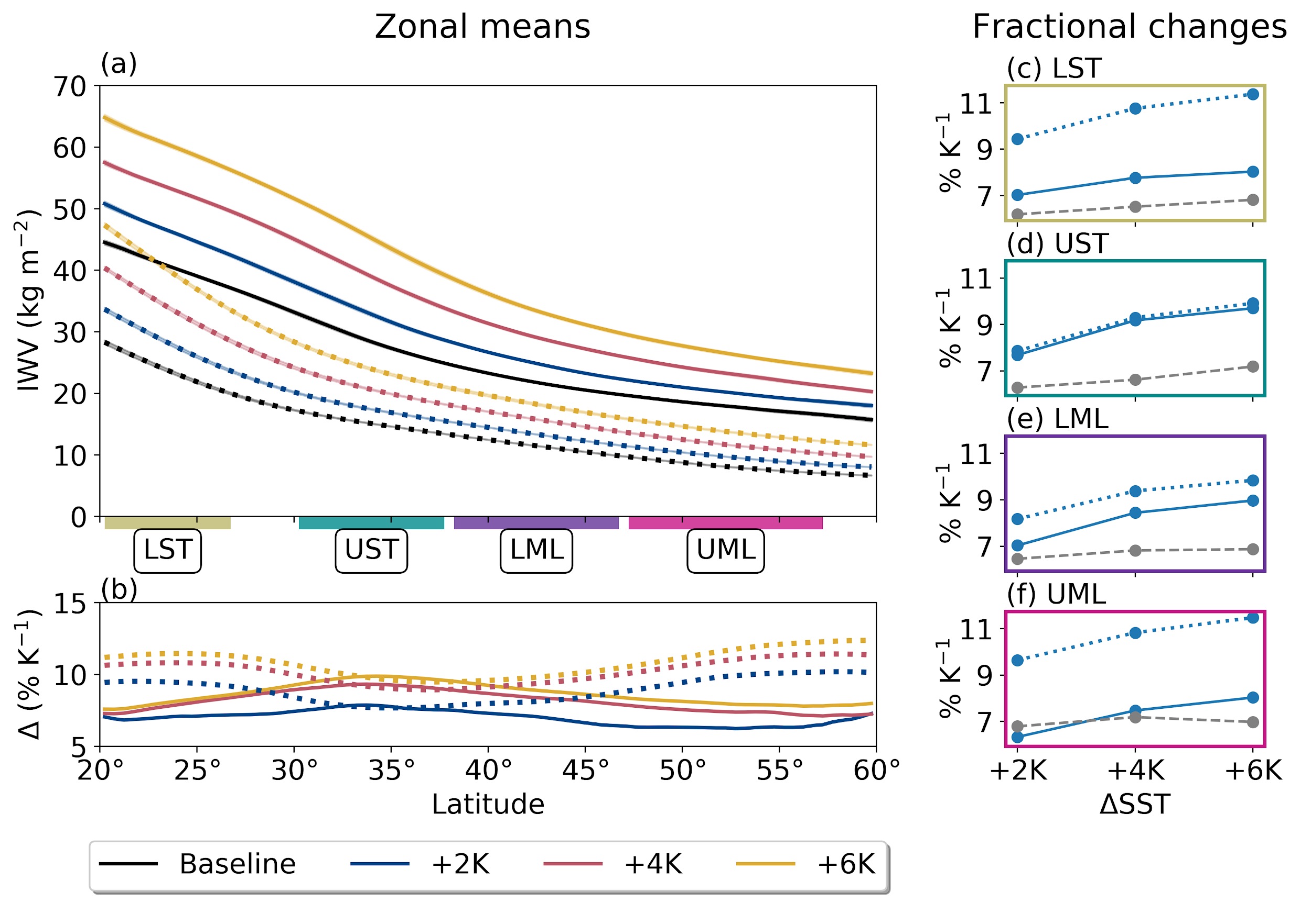
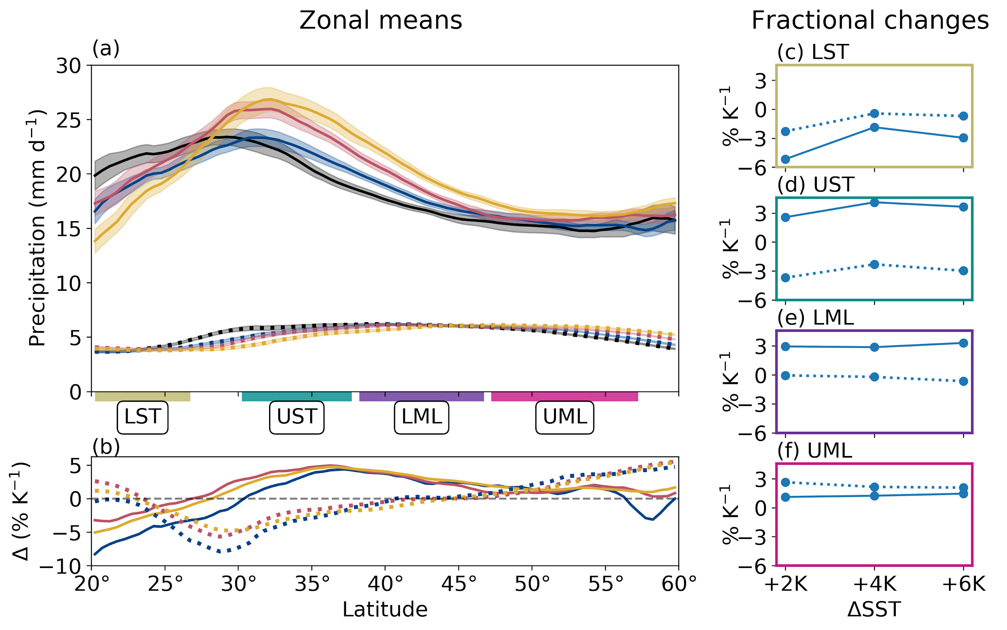
Sensitivity of atmospheric river vapor transport and precipitation to uniform sea-surface temperature increases
We find that column moisture in atmospheric rivers (ARs) increases more than anticipated by sea-surface temperature (SST) warming, and that this large increase masks drying aloft. Meanwhile, weakening dynamics tend to attenuate increases in AR vapor transport and precipitation compared to column moisture changes.
Simplified experimental design allows us to establish physical relationships and validate model responses against theoretical predictions.
Results ultimately build confidence in climate change projections of ARs by allowing us to accurately attribute changes in ARs to individual climate change forcings.
Community Atmosphere Model version 5 (CAM5) in idealized “aquaplanet” configuration (a water-covered world) is used with four SST scenarios: a Baseline similar to present-day conditions, and three runs with +2, +4, and +6K warming over the Baseline.
ARs are identified over each two-year integration using an objective algorithm conditioned on moisture transport convergence.
Mathematical decomposition of complex physical processes into simple constituents elucidates relative roles of thermodynamics and dynamics in AR vapor transport and precipitation changes.
Fig. 1 (top): (a) Zonal means of AR (solid) and non-AR (dotted) integrated water vapor (IWV). (b) Zonal mean fractional IWV change per degree warming in AR and non-AR points. (c)-(f) Mean fractional IWV changes for AR and non-AR points in the latitude ranges shown by the colored boxes on (a). Grey dashes show predictions by SST increase. Fig. 2 (bottom): Same as Fig. 1, but for precipitation rate.
McClenny, E. E., Ullrich, P. A., & Grotjahn, R. (2020). Sensitivity of atmospheric river vapor transport and precipitation to uniform sea‐surface temperature increases. Journal of Geophysical Research: Atmospheres, 125, e2020JD033421. https://doi.org/10.1029/2020JD033421

