Slide 1
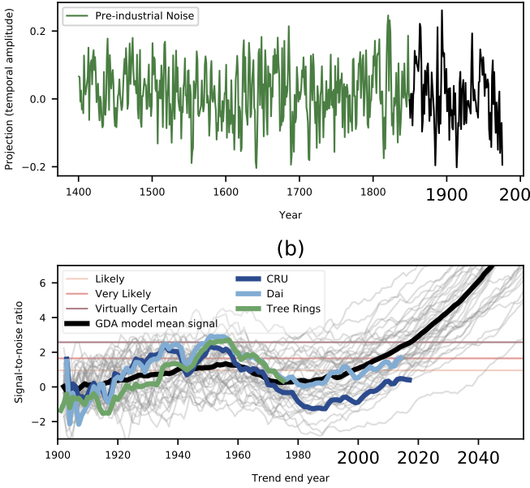
Twentieth century hydroclimate changes consistent with human influence
Kate Marvel, Benjamin I. Cook, Céline Bonfils, Paul J. Durack, Jason E. Smerdon, and A. Park Williams
Nature
Using CMIP5 models, we obtained a “fingerprint” of greenhouse gases on the Palmer Drought Severity Index (PDSI). This appears similar to their fingerprint on surface and root zone soil moisture. Models indicate that 1900-1949 observations should increasingly resemble this fingerprint. In the middle of the 20th century models indicate a decreasing resemblance, followed by an increase post-1980.
We collated multiple tree ring-based datasets to obtain a “Global Drought Atlas” (GDA) of PDSI reconstructions from 1400-1975. Projecting pre-1850 GDA data onto the fingerprint yielded a measure of preindustrial climate variability- noise. The tree ring reconstructions and two observational datasets showed a detectable signal in the period 1900-1949.
We performed a formal detection and attribution analysis for three periods:
1900-1949: The signal is detectable: highly unusual to have arisen from internal variability (which we estimate from pre-1850 GDA data and CMIP5 piControl simulations. It is attributable to the collection of external forcings included in the CMIP5 simulations.
1950-1975: The signal is negative and unlikely to have arisen from internal variability alone. It suggests a possible role for aerosol forcing, although the fingerprint of aerosols remains poorly understood due to uncertainties in aerosol emissions, radiative forcing, and hydroclimate response.
1980-2017: The signal is once again positive, but has not yet re-emerged from the “noise” of naturally forced variability. This may be related to recent “hiatus” conditions characterized by anomalously cool equatorial Pacific SSTs and relatively muted warming.

