Slide 1
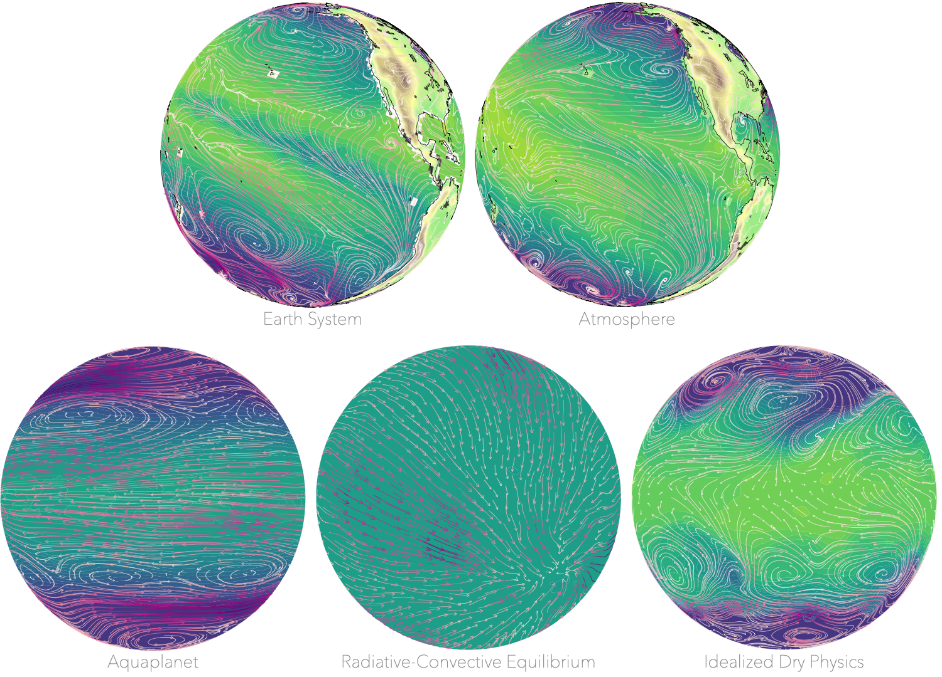
Model Hierarchies for Understanding Atmospheric Circulation
Penelope Maher, Edwin P. Gerber, Brian Medeiros, Timothy M. Merlis, Steven Sherwood, Aditi Sheshadri, Adam H. Sobel, Geoffrey K. Vallis, Aiko Voigt, Pablo Zurita‐Gotor Reviews of Geophysics, https://doi.org/10.1029/2018RG000607
Objective
Highlights the complementary relationship between simple and comprehensive models in addressing key scientific questions to describe Earth's atmospheric circulation.
Approach
Models to understand atmospheric circulation are organized into three types: the dynamical hierarchy, the process hierarchy, and the hierarchy of scale.
The application of the hierarchical approach is reviewed for the midlatitude circulation, the middle atmosphere, and tropical circulation
The still-emerging topic of applying hierarchical approaches to the coupling between clouds, convection, and circulation is presented
Impact
Model hierarchies help address open research questions. We focus on how they have improved our understanding of atmospheric circulation.
Model hierarchies are commonly referred to but remain poorly defined. We identify three principles to organize models into hierarchies.
Key benchmark models of the atmospheric circulation are identified and connected to comprehensive models through model hierarchies.
Models available within the hierarchy in the CESM system. Top (L-R): the Earth system model (ESM) and atmosphere only models (AGCM with prescribed SST). Bottom (L-R): Aquaplanet, RCE and idealized dry physics. The color contours over the ocean are SST and over land topography. Streamlines are the near-surface wind (thicker lines are stronger winds). Each globe is a monthly mean except for the idealized dry model which is a snapshot.

