Slide 1



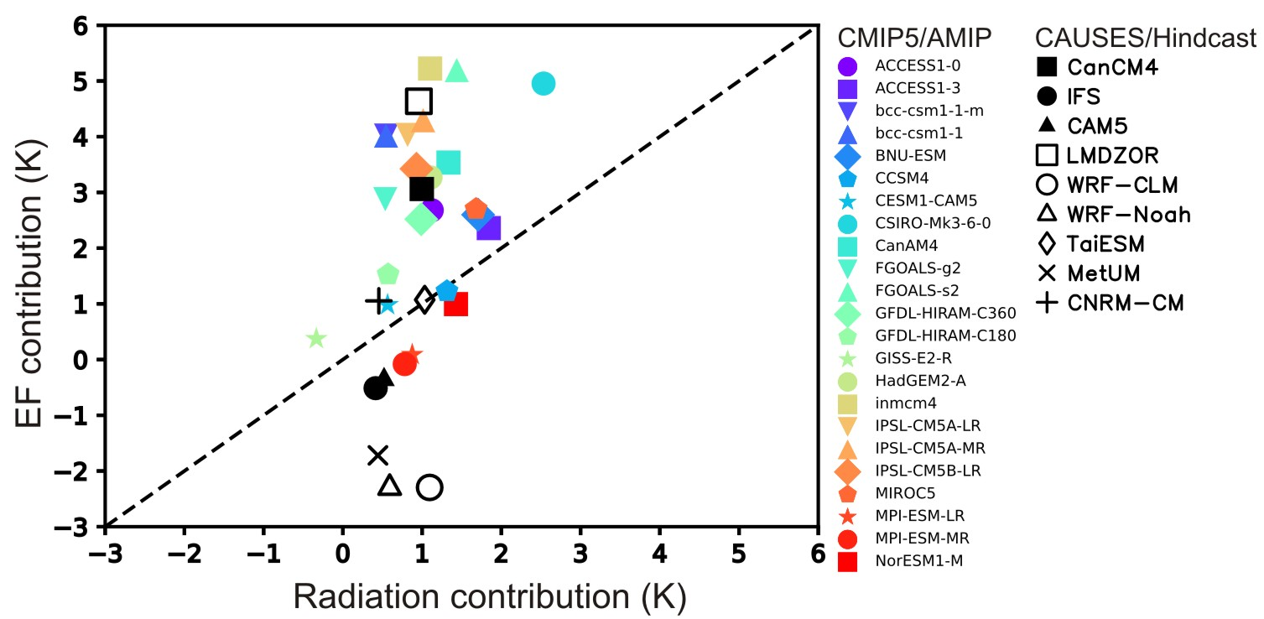
The relative role of surface energy budget on the warm surface air temperature bias over the Central U.S.
RGCM
Science Question
What are the relative error contributions in the surface energy budget to the surface warm air temperature (T_{2m}) bias seen in many weather forecast and climate model simulations?
T_{2m} bias contribution
Models with larger warm surface air temperature bias are mostly associated with larger evaporative fraction bias (less evaporation).
Key Accomplishments
Biases in the net surface shortwave, downward longwave fluxes and evaporative fraction (EF) are the main contributors to warm T_{2m} biases.
Radiation and EF biases are associated with clouds, precipitation, evaporation and soil moisture biases.
Biases in EF are generally more important than biases in radiation in explaining larger temperature biases.
Ma, H.-Y. and coauthors (2018), CAUSES: On the role of surface energy budget errors to the warm surface air temperature error over the Central U.S. J. Geophys. Res. Atmospheres, doi:10.1002/2017JD027194.
Notes:
Evaporative Fraction (EF: the ratio of latent heat flux to the sum of latent and sensible heat fluxes)

