Slide 1
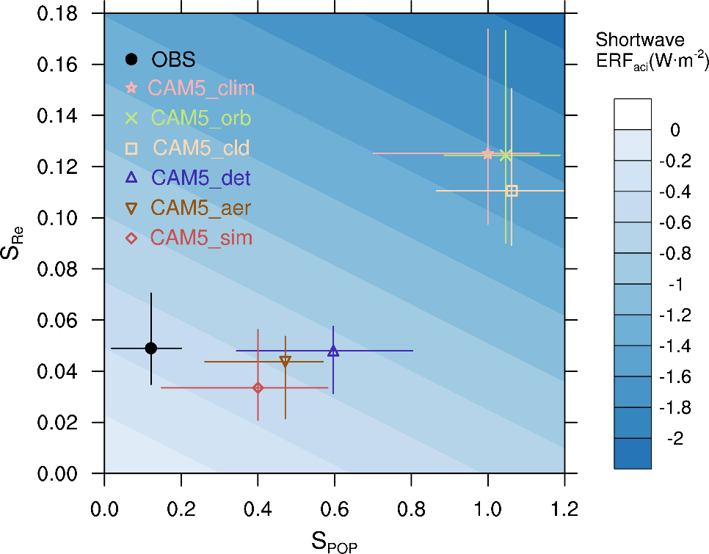
Current Strategies Using Satellite Data Limit the Accuracy of Space-Based Estimates of How Aerosols Brighten Clouds
Objective
Understand the differences between model and observational estimates of cloud susceptibility to aerosols
Approach
Develop and implement an aerosol lidar simulator in CAM5 to simulate CALIPSO satellite sampling and retrieval procedures
Produce a GCM-Oriented CALIPSO Aerosol Product (GOCAP) data set to facilitate fair comparison between models and observations
Explore impacts of MODIS aerosol retrieval limitation and uncertainty on susceptibility estimates
Impact
Identified components of satellite aerosol retrieval procedures responsible for susceptibility errors and quantified observational requirements needed to improve the estimates
Findings suggest that conventional model-satellite comparison strategies may lead to scientific misunderstanding and drive model development efforts in the wrong direction
Study suggests that using nighttime lidar measurements could provide a more accurate susceptibility estimate
A lot of the discrepancy between model and observational estimates of susceptibilities as well as the inferred aerosol indirect forcing can be explained by retrieval limitations, especially in clean environments.
Ma P-L, PJ Rasch, H Chepfer, DM Winker, and SJ Ghan. 2018. “Observational Constraint on Cloud Susceptibility Weakened by Aerosol Retrieval Limitations.” Nature Communications 9:2640. DOI: 10.1038/s41467-018-05028-4
Notes:
http://www.pnnl.gov/science/highlights/highlights.asp?division=749

