Slide 1
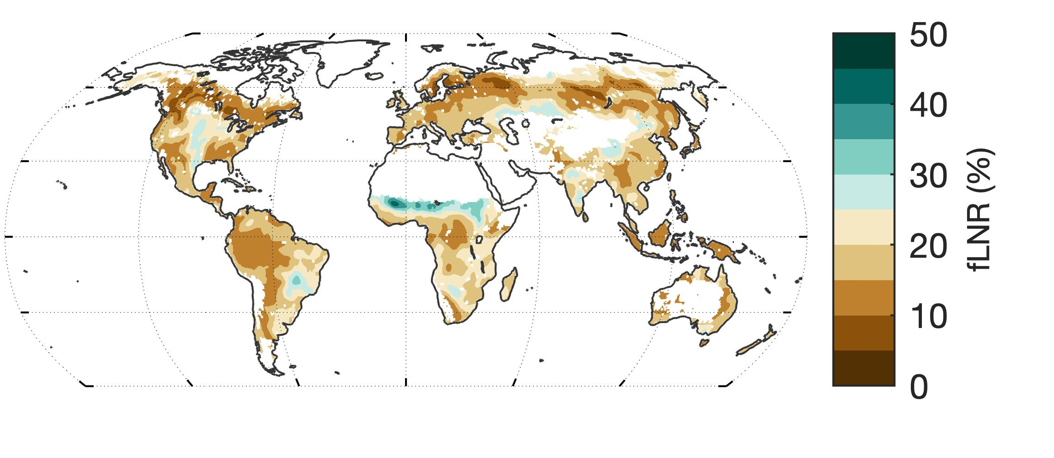
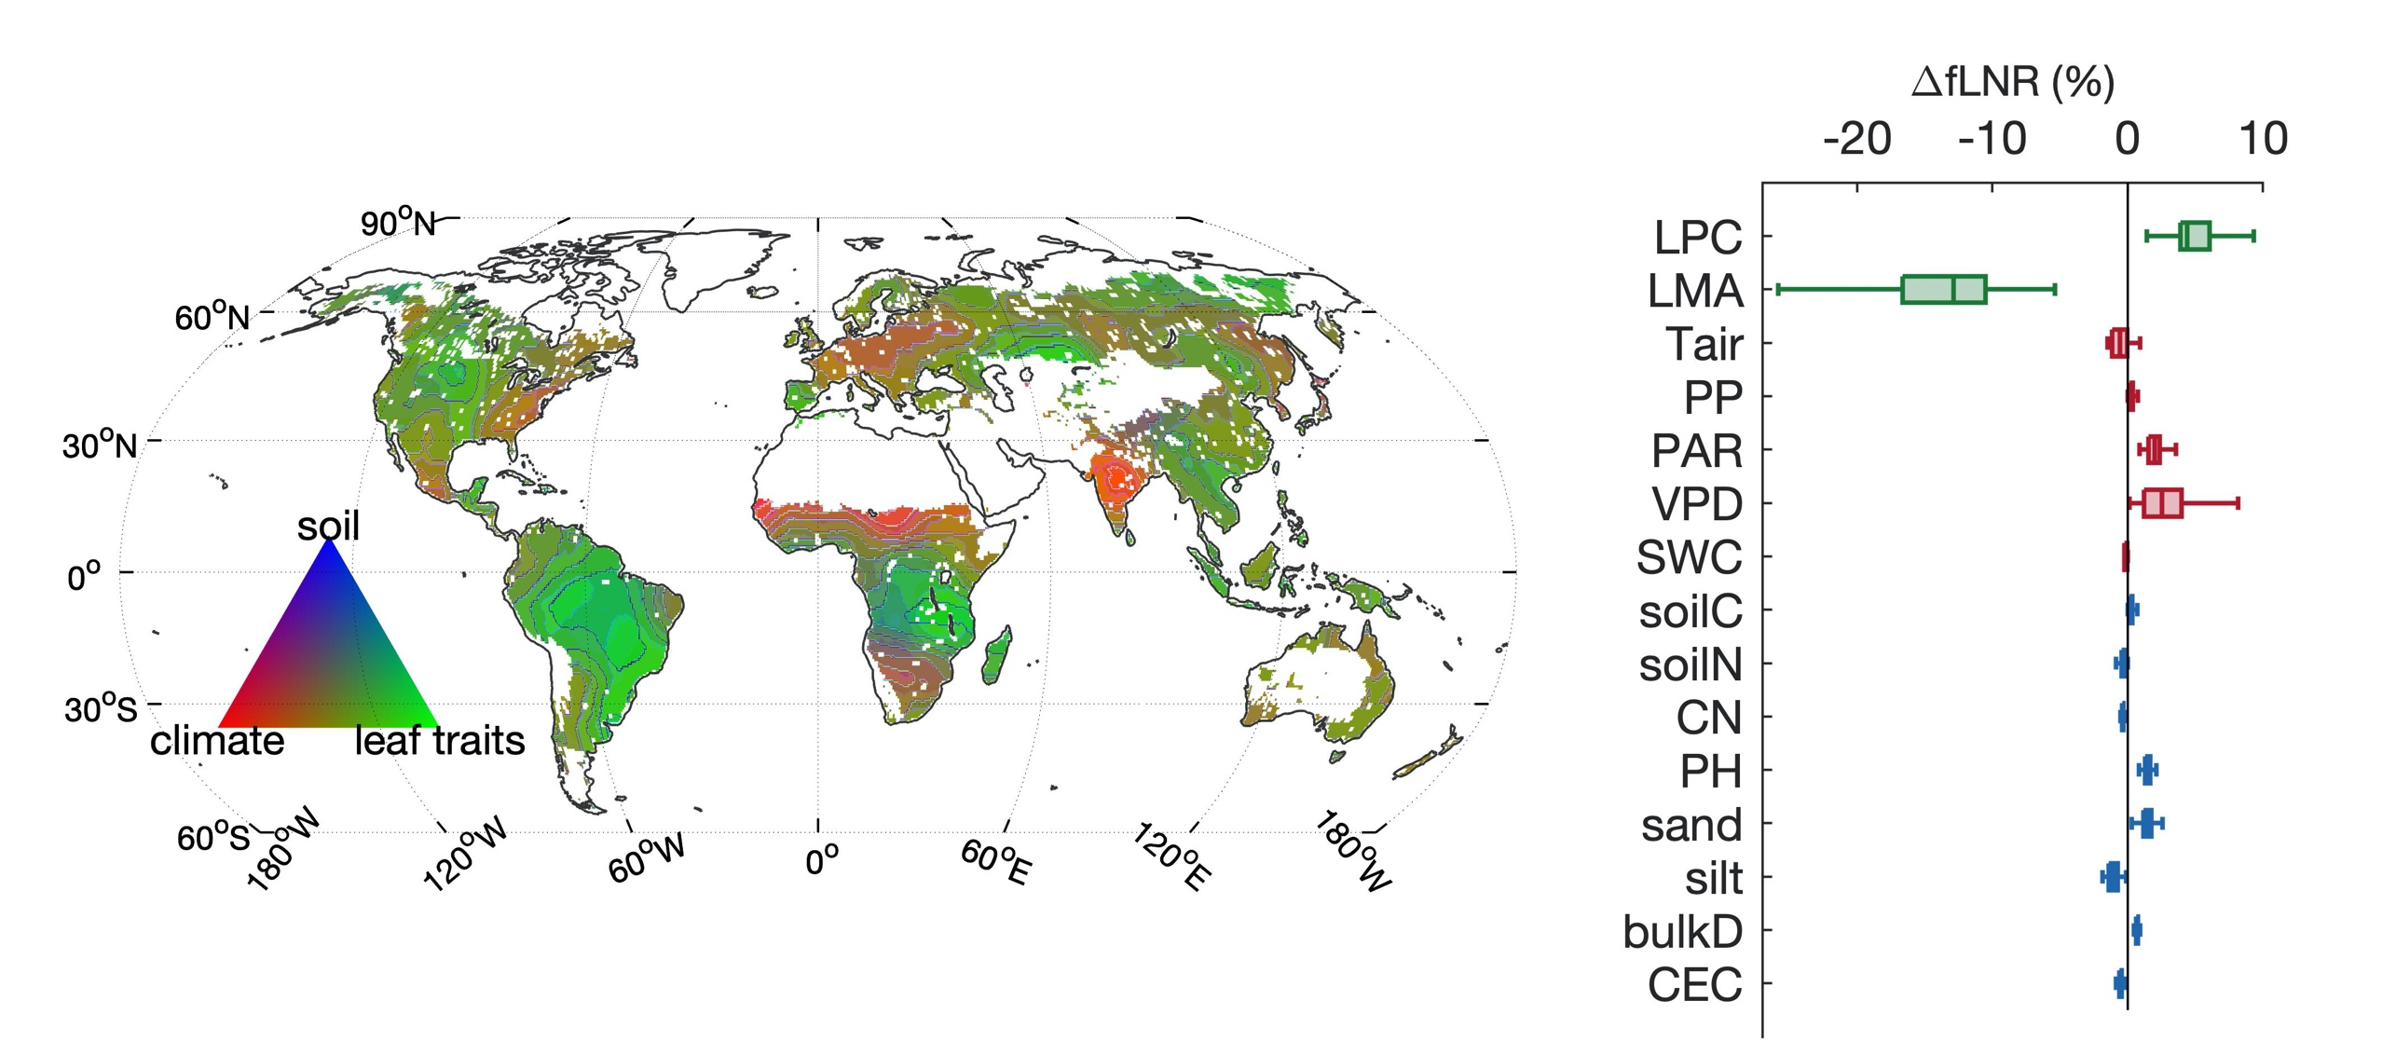

Global variation in the fraction of leaf nitrogen allocated to photosynthesis
Scientific Achievement
Understanding how much nitrogen is allocated to RuBisCO (fLNR) is critical to our understanding of plant nitrogen use strategy and the estimation of global photosynthesis.
We find global fLNR is 18.2 ± 6.2%, with its variation largely driven by leaf thickness and phosphorus, while soil and climate have substantial regional influences.
Significance and Impact
Our study provides a data-driven map of fLNR and Vcmax25 to constrain a key source of uncertainty in global carbon model parameterization.
We identify the key biotic and abiotic controls on the variation in fLNR, and provide insight on the nitrogen use strategy of global vegetation.
Figure: (top) Global variation in the fraction of nitrogen allocated to RuBisCO (fLNR) and (bottom) its dominant controls
Research Details
We use a comprehensive database of in-situ observations, a remote sensing product of leaf chlorophyll and ancillary climate and soil data, to examine the global distribution in fLNR using a random forest model.
Luo, X., Keenan, T.F. et al. 2021 Global variation in the fraction of leaf nitrogen allocated to photosynthesis. Nature Communications, 12, 4866
DOI: 10.1038/s41467-021-25163-9

