Slide 1
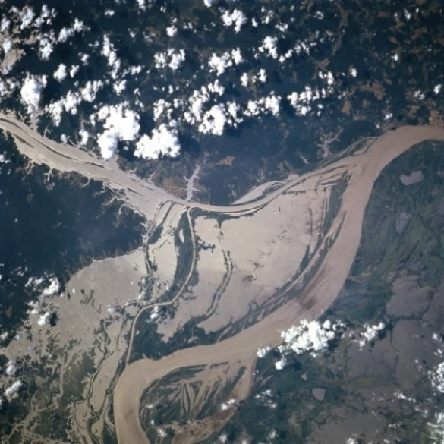

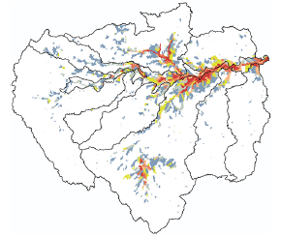

Representing Floodplain Inundation in an Earth System Model
Objective
Implement and improve modeling of floodplain inundation in basins with evident inundation
Approach
Implement a macroscale floodplain inundation scheme in the Model for Scale Adaptive River Transport (MOSART), which is a key component of the DOE’s ACME earth system model
Improve the inundation scheme by refining floodplain topography, channel morphology, and river flow representation
Apply the extended MOSART model (MOSART-Inundation) to the Amazon basin
Evaluate the simulations using in situ streamflow records and satellite data of water level and inundation area
Inundated floodplains adjacent to the lower Amazon River in June 1996 (from Earth Science and Remote Sensing Unit, NASA Johnson Space Center)
Flooded fraction areas in the Amazon basin simulated by MOSART-Inundation for April-June averaged between 1995 and 2007
Impact
Representing floodplain inundation can improve simulation of surface hydrology, which has significant impacts on the regional water and biogeochemical cycles
Improved modeling of streamflow and inundation extent provides a foundation for predicting the impacts of global change on water resources and flood hazards in earth system models
Luo X, H-Y Li, LR Leung, TK Tesfa, A Getirana, F Papa, and LL Hess. 2017. “Modeling Surface Water Dynamics in the Amazon Basin Using MOSART-Inundation v1.0: Impacts of Geomorphological Parameters and River Flow Representation.” Geoscientific Model Development 10, 1233-1259. DOI: 10.5194/gmd-10-1233-2017
Notes:
http://www.pnnl.gov/science/highlights/highlights.asp?division=749

