Slide 1
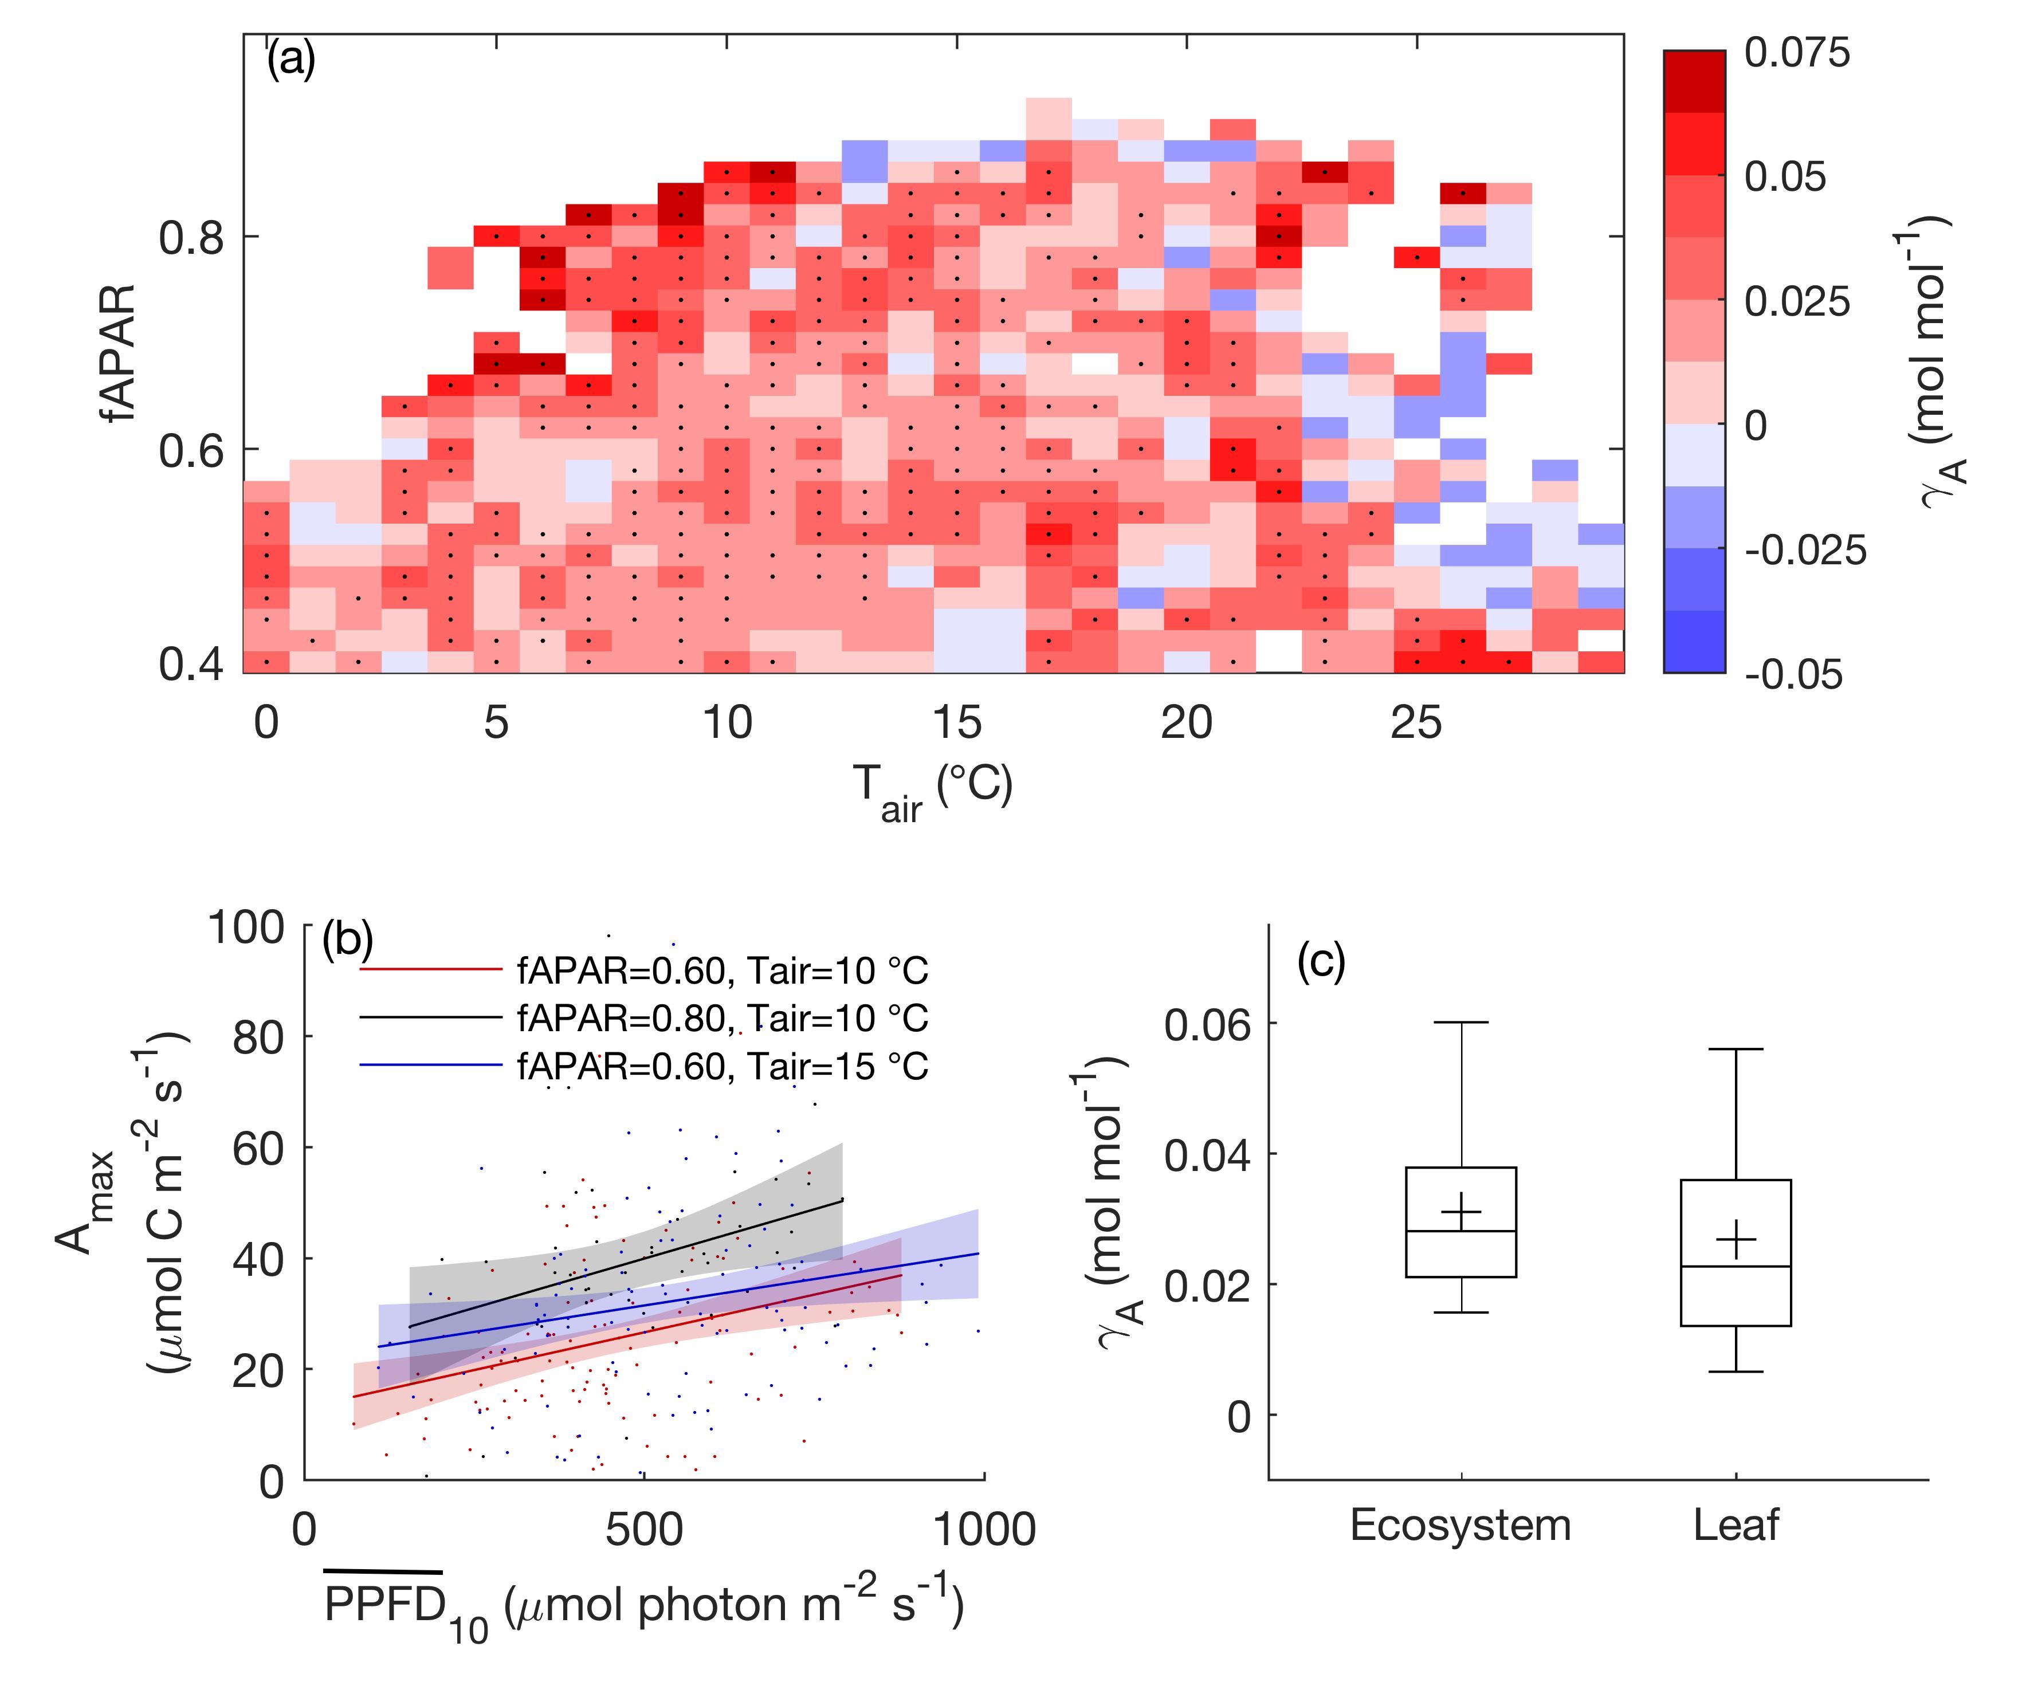

Global evidence for the acclimation of ecosystem photosynthesis to light
Scientific Achievement
The first evidence is reported that ecosystems acclimate their maximum photosynthesis to changes in light, a process that is not effectively incorporated into models.
Using an optimality theory to incorporate light acclimation in models improved photosynthesis estimates
Significance and Impact
Global photosynthesis is the largest carbon flux on Earth.
Multi-scale observations demonstrate the widespread existence of photosynthetic light acclimation
Results show that current terrestrial biosphere models (TBMs) do not to accurately represent light acclimation
Figure: Ecosystem light acclimation rate (γ_{A}) inferred from eddy covariance measurements and tabulated by temperature and leaf foliage density, and the comparison of ecosystem light acclimation rate to previously reported leaf light acclimation rate.
Research Details
This analysis combines measurements from eddy covariance towers, models and satellite observations to infer ecosystem light acclimation, and uses the results to evaluate terrestrial biosphere models.
Luo, X. & Keenan, T.F. Global evidence for the acclimation of ecosystem photosynthesis to light. Nature Ecology & Evolution.10.1038/s41559-020-1258-7.

