Slide 1
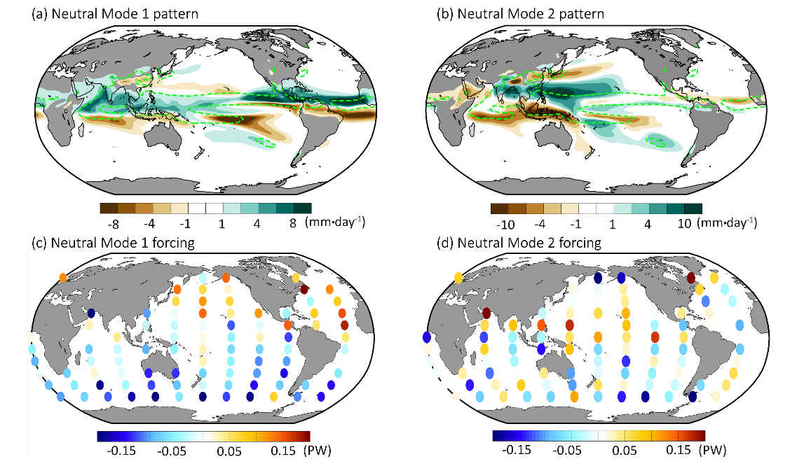
Recurrent Rainfall Patterns as Important Modes of Asian Monsoon Variability
Objective
Investigate the dynamical modes of the Asian Monsoon variability to form an interpretation framework for seasonal extreme precipitation events.
Approach
Use the Community Atmospheric Model coupled to a slab ocean to perform a large set of Green’s function experiments, in which ocean heat flux patches are applied one patch at a time.
Make use of the forcing-response function for boreal summer precipitation.
Construct a two-dimensional energy balance model to predict the rainfall response pattern.
Impact
The record-breaking 2020 Chinese monsoon season can be partly explained as a mode response in resonance with the ocean dynamical forcing.
Neutral mode analysis pairs the most excitable modes (right Figure a and b) to the corresponding patterns of the ocean heat flux (right Figure c
and d).
The projected, slow-evolving trend towards the “south flood-north-drought” pattern in China may originate in ocean dynamics.
Singular value decomposition allows researchers to separate the precipitation response into neutral modes and link each pattern to the underlying optimal forcing. Panels (a) and (b) show the first two neutral modes, with their corresponding forcing patterns in panels (c) and (d), respectively. The pattern of Mode 2 matches the precipitation anomaly of summer 2020 over the Asia-west Pacific sector well.
J. Lu, D. Xue, L. R. Leung, F. Liu, F. Song, B. Harrop, & W. Zhou. ″The Leading Modes of Asian Summer Monsoon Variability as Pulses of Atmospheric Energy Flow.” Geophysical Research Letters, 48, (2021). e2020GL091629. https://doi.org/10.1029/2020GL091629
Notes:
http://www.pnnl.gov/science/highlights/highlights.asp?division=749

