Slide 1
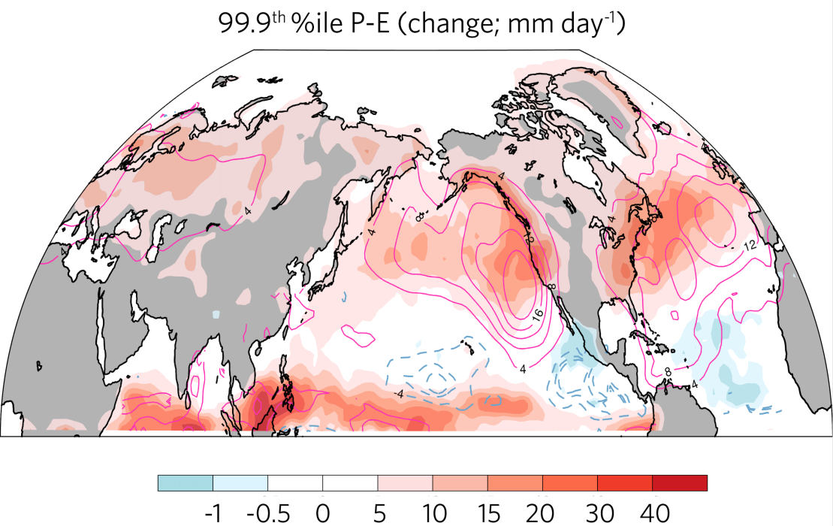
Wetter Winters in the Western U.S.: Regional Hydrological Extremes Revealed from Water Vapor Wave Activity
Objective
Understand how regional hydrology and extremes respond to climate warming with a more conservative diagnostic framework
Approach
Develop a geometric transformation of the column water vapor budget to represent local hydrological cycles
Apply local water vapor wave activity (LWA) analysis to characterize the atmospheric rivers in the RCP8.5 climate change scenarios simulated by CMIP5 models
Impact
The new diagnostic allows more rigorous study of hydrological extremes at regional scale
Atmospheric rivers landfalling at U.S. coasts become more frequent and longer, leading to marked increases in wet extremes over the Western United States
Two metrics for hydrological extremes―the 99.9th percentile of precipitation minus evaporation and the corresponding LWA sink―show significant changes over coastal North America as simulated by the CMIP5 multi-model ensemble mean for RCP8.5 for future (2070-2099) and historical (1976-2005) scenarios.
Lu J, D Xue, Y Gao, G Chen, LR Leung, and P Staten. 2017. “Enhanced Hydrological Extremes in the Western United States under Global Warming through the Lens of Water Vapor Wave Activity.” npj Climate and Atmospheric Sciences, in press. DOI: 10.1038/s41612-018-0017-9

