Slide 1
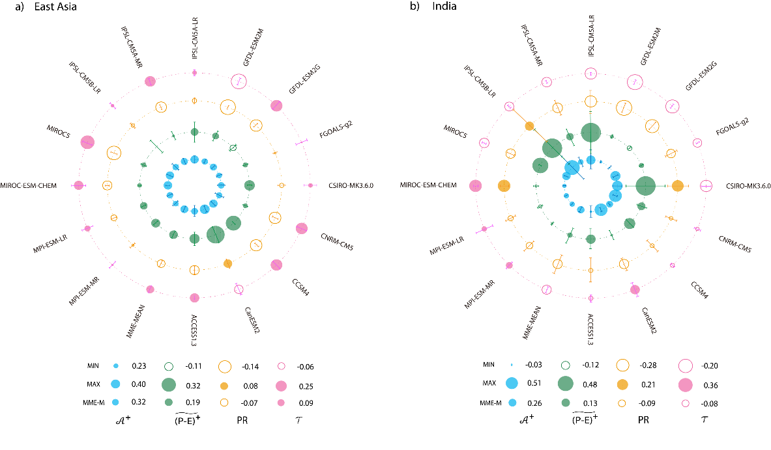
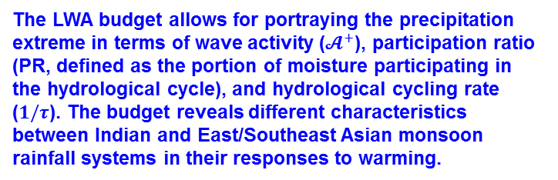
Looking at Monsoon Rainfall Response
to Climate Warming Through a New Lens
Objective
Understand how monsoon precipitation extremes respond to climate warming from the perspective of hydrological cycle
Approach
Apply local water vapor wave activity (LWA) analysis to characterize the hydrological cycle over Asian monsoon regions in the RCP8.5 climate warming scenario
Impact
This LWA diagnostic allows for more rigorous study of hydrological extremes at a regional scale, with the resultant LWA sink as a useful metric for precipitation extremes
Hydrological cycling rate increased in the Indian monsoon region and decreased in the East/Southeast Asian region; the precipitation extreme increased in both regions
Distinct characteristics in the hydrological cycling rate imply differing dynamical mechanisms governing the response of precipitation extremes between Indian and East/Southeast Asian monsoons to warming
East/Southeast Asia
India
The LWA budget allows for portraying the precipitation extreme in terms of wave activity ($𝓐^{+}$), participation ratio (PR, defined as the portion of moisture participating in the hydrological cycle), and hydrological cycling rate ($1/τ$). The budget reveals different characteristics between Indian and East/Southeast Asian monsoon rainfall systems in their responses to warming.
Xue D, J Lu, LR Leung, and Y Zhang. 2018. “Response of the Hydrological Cycle in Asian Monsoon Systems to Global Warming Through the Lens of Water Vapor Wave Activity Analysis.” Geophysical Research Letters 45(21):11,904−11,912. https://doi.org/10.1029/2018GL078998

