Slide 1
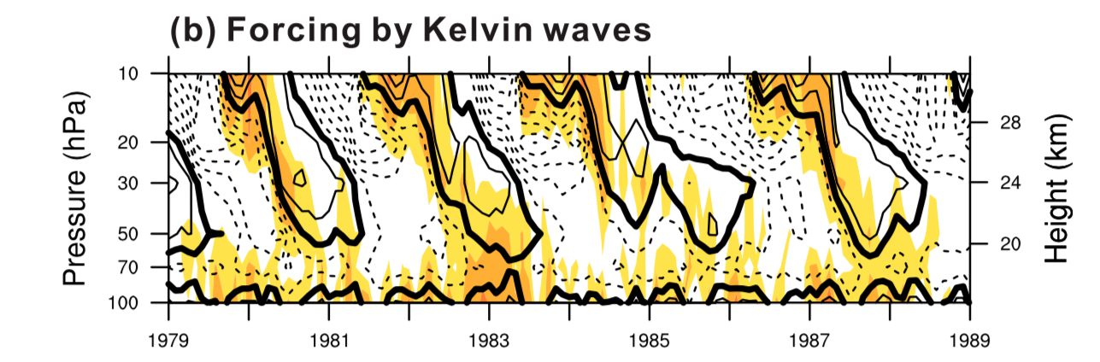
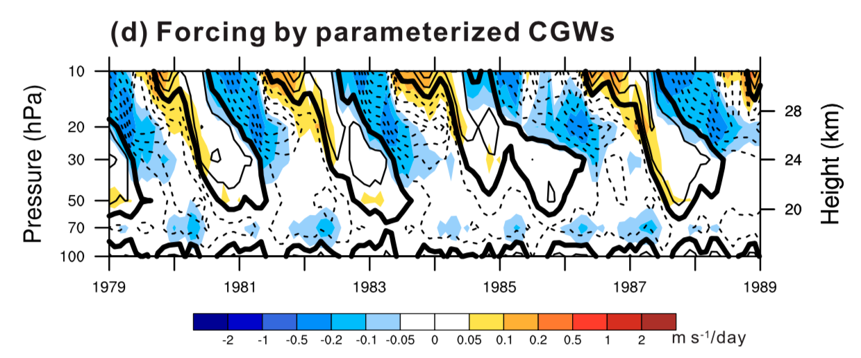
Variability of the Stratospheric Quasi-Biennial Oscillation and Its Wave Forcing Simulated in the Beijing Climate Center Atmospheric General Circulation Model.
Lu, Y., T. Wu, W. Jie, A. A. Scaife, M. B. Andrews, and J. H. Richter, 2020: Variability of the Stratospheric Quasi-Biennial Oscillation and Its Wave Forcing Simulated in the Beijing Climate Center Atmospheric General Circulation Model.
J. Atmos. Sci., 77, 149–165, https://doi.org/10.1175/JAS-D-19-0123.1
OBJECTIVE
The quasi-biennial oscillation (QBO) of the zonal mean wind is the primary mode of variability of the lower tropical stratosphere. It is understood that the QBO is forced by a combination of large scale and smaller scale waves, however the relative contributions from different types of waves are not clear. This study examines in detail the forcing of the QBO.
APPROACH
A general circulation model simulation is used with vertical resolution that was increased from 26 to 68 levels and a source-oriented gravity wave parameterization was added into a GCM in some simulations.
IMPACT
It was found that the increase in vertical resolution alone is not enough to generate a realistic QBO; Small-scale (~ 100 km) waves are needed to provide a portion of the driving. Kelvin waves are the primary driver of the eastward phase, whereas parameterized small-scale gravity waves are the main driver of the westward phase of the QBO.
Time-height cross sections of wave forcing from Kelvin waves (top) and parameterized gravity waves (bottom). Zonal mean zonal wind averaged between 5ºS and 5ºN is superimposed in thick black lines.

