Slide 1
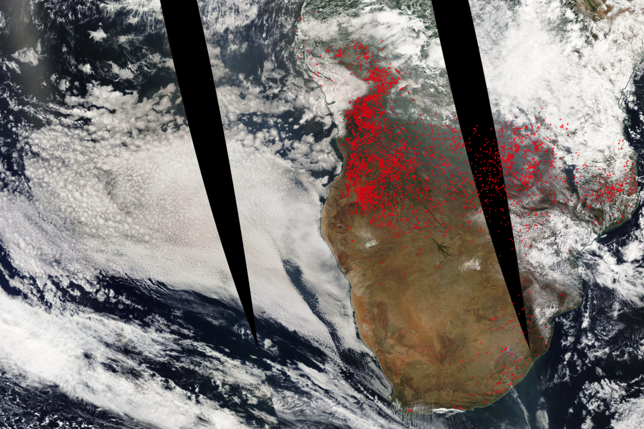
Biomass smoke from southern Africa cools the climate by significantly enhancing the brightness of stratocumulus over S.E. Atlantic
Objective
To quantify the climatic effect of biomass smoke from S. Africa on stratocumulus over S.E. Atlantic.
Approach
Used satellite observations to identify the mixing frequency of biomass smoke from S. Africa with stratocumulus underneath;
Conducted high-resolution WRF in large-eddy mode and WRF-Chem nested model simulations, validated with observations, to quantify the smoke aerosol microphysical and radiative effects.
Impact
Biomass burning aerosols over S.E. Atlantic during the fire season (July-September) can cause a substantial cooling (daily mean −8.05 W m⁻²) in the region, primarily as a result of clouds brightening by reducing the cloud droplet size (the Twomey effect) and secondarily through modulating the diurnal cycle of cloud liquid water path and coverage (the cloud lifetime effect).
During the fire season (July-October) large amount of biomass burning smoke aerosols are emitted in S. Africa and transport across S.E. Atlanta. In this study, we found that at 50% of the times smokes are mixed with the semi-permanent stratocumulus decks underneath. Using the high resolution WRF-Chem and WRF-LES models, we found that smoke can cause a strong climate cooling (-8.05 W m⁻²) in the region by affecting cloud microphysics.
Lu, Z., X. Liu, Z. Zhang, C. Zhao, K. Meyer, C. Rajapakshe, C. Wu, Z. Yang, and J. E. Penner (2018), Biomass smokes from southern Africa can significantly enhance the brightness of stratocumulus over southeastern Atlantic Ocean, Proceedings of the National Academy of Sciences of USA, 115, 2924–2929.

