Slide 1
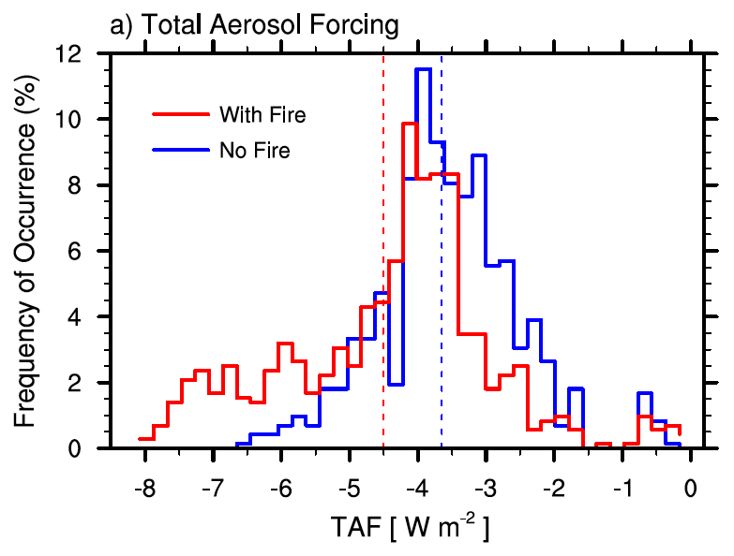
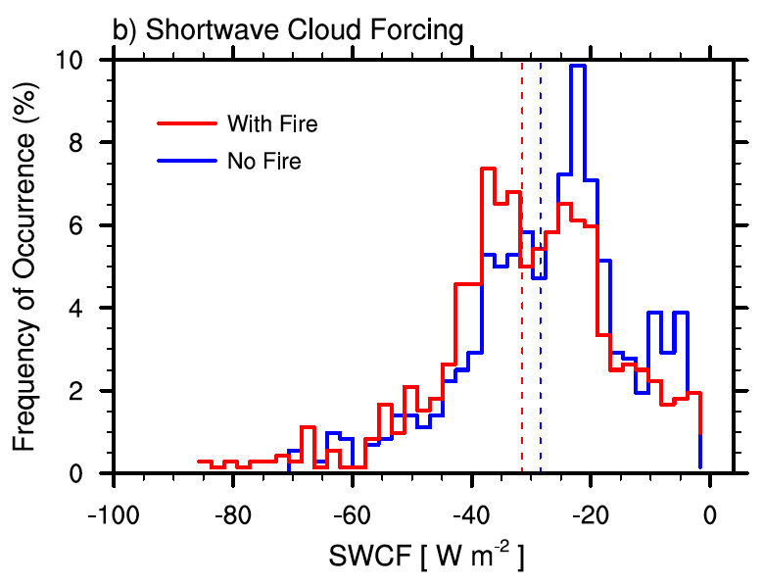
Fire Particles Have Large Radiative Effects on Short Timescales
Objective
Investigate the short-term effective radiative forcing of fire aerosols
Approach
Perform short (10-day) nudged ensemble simulations with and without fire emissions to estimate the effective radiative forcing
Quantify the forcing uncertainty due to the chaotic response to small perturbations in the atmospheric state
Impact
Fire aerosols found to have large effects on both liquid and ice clouds
Ensemble spread of regional mean shortwave cloud radiative effect is much larger when using daily averages instead of 10-day averages
Study demonstrates the importance of using a large ensemble of simulations to estimate the short-term aerosol effective radiative forcing
Fire aerosols have a large impact on the frequency of (a) total aerosol forcing (TAF); and (b) shortwave cloud forcing (SWCF), as the shifted distribution demonstrates.
Liu Y, K Zhang, Y Qian, Y Wang, Y Zou, Y Song, H Wan, X Liu, and X-Q Yang. 2018. “Investigation of Short-Term Effective Radiative Forcing of Fire Aerosols Over North America Using Nudged Hindcast Ensembles.” Atmospheric Chemistry and Physics 18:31-47. DOI: 10.5194/acp-18-31-2018
Notes:
Using a new modeling strategy, researchers found that fire aerosols can alter both liquid and ice clouds that reflect or absorb energy.
The Science
Aerosols in the atmosphere can affect cloud properties to either absorb or reflect energy, thereby altering Earth’s incoming and outgoing energy—or radiative energy—balance. However, aerosols created by fires are often intermittent, so it is difficult to estimate the resulting warming or cooling effects, referred to as radiative forcing. Researchers at the U.S. Department of Energy’s Pacific Northwest National Laboratory led a study using a new ensemble modeling strategy to investigate the short-term effects of fire aerosols on energy balance. They found that fire aerosols can significantly influence the radiative effects of both liquid and ice clouds.
The Impact
Previous modeling studies seldom examined the uncertainty in simulated effects of fire aerosols on clouds. Because of the chaotic model response to small perturbations in the atmospheric state, this study showed the importance of using a large ensemble of simulations to improve estimates of short-term warming or cooling from fire aerosols.
Summary
Through interactions with radiative energy and clouds, fire aerosols can significantly affect Earth’s long-term energy balance. On short timescales, fire aerosols have even larger radiative effects, such as altering the cloud albedo (reflectivity) that makes the clouds brighter, or heating the upper troposphere, which inhibits convection. Researchers investigated the short-term radiative forcing of fire aerosols using the Community Atmosphere Model version 5 (CAM5), a global aerosol-climate model. Unlike previous studies that mostly used a single simulation, researchers performed nudged ensemble simulations and investigated the ensemble mean and spread of the aerosol and cloud radiative effects. Because the model is nudged toward reanalysis data, the observed large-scale circulation feature is well simulated, and the modeled aerosol and cloud properties can be evaluated against observation data. The ensemble strategy helps to quantify the uncertainty in the simulated fire aerosol effect on cloud radiative forcing due to the chaotic model response to small atmospheric perturbations. Researchers used daily mean fire emission data from different fire inventories to consider the uncertainty in fire sources. Overall, the model demonstrated reasonably good predictive skills in simulating aerosol optical thickness and surface mass concentrations.
Researchers then performed short (10-day) nudged ensemble simulations, with and without fire aerosols, to estimate the effective radiative forcing. They analyzed aerosol properties and radiative effects over southern Mexico and the central United States in April 2009. Both regions experienced relatively large fires in 2009, and April is the peak month of spring burning. Results showed that fire aerosols had large effects on liquid and ice clouds over both regions. Researchers noted a strong negative shortwave cloud radiative effect (SCRE)—or cooling—over southern Mexico, with a 10-day regional mean value of −3.0 W m⁻². Over the central United States, the SCRE was positive—warm—in the north but negative in the south, and the regional mean SCRE was small (−0.56 W m⁻²). For the 10-day average, researchers found a large spread of regional mean SCRE in the ensemble simulations over both regions, even though the regional mean aerosol optical depth was almost indistinguishable. Moreover, the ensemble spread was much larger when using daily averages instead of 10-day averages. This demonstrates the importance of using a large ensemble of simulations to estimate the short-term aerosol effective radiative forcing.

