Slide 1
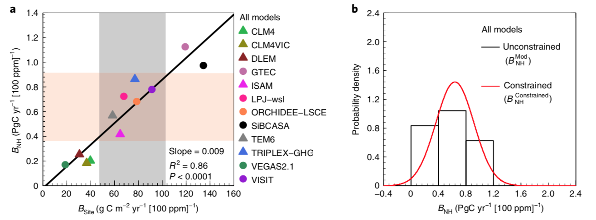
The enhancement of the terrestrial carbon sink by CO₂ fertilization
Scientific Achievement
We identify a strong effect of eCO₂ on the global terrestrial sink, modulated by both climate and nutrient availability.
We identify an emergent data-constrained eCO₂ sensitivity of 0.64 ± 0.28 PgC yr⁻¹ per hundred ppm of eCO₂.
Extrapolating worldwide, this northern temperate sensitivity projects the global terrestrial carbon sink to increase by 3.5 ± 1.9 PgC yr⁻¹ for an increase in CO₂ of 100 ppm.
Significance and Impact
These results demonstrate the potential of combining models with results from ecological experiments.
They also suggest large past and potential future increases in the global terrestrial sink due to the effect of elevated CO₂, emphasizing the importance of using experimental observations to constrain land surface models.
Above: a) Relationship between the Northern Hemisphere temperate zone and the site-scale responses of the terrestrial carbon sink to eCO2 (ΒNH and ΒSite) across MsTMIP models. ΒSite is based on MsTMIP model simulation for a change from 320ppm to 380ppm and an extrapolation of FACE experiments. The light grey area shows the emergent observational constraint. b) The histogram indicates the probability density function of unconstrained model B (BMod). The red line indicates the constrained PDF.
Research Details
We use ecosystem models and globally distributed ground observations from eCO₂ experiments to assess the effect of CO₂ on the terrestrial carbon sink.
We develop methods to bridge the scales between ground observations, and models, to quantify the effect of CO₂ on ecosystem function.
Liu, Y. Piao, S., Gasser, T., Ciais, P., Yang, H., Wang, H., Keenan, T.F., et al. (2019) Field-experiment constraints on the enhancement of the terrestrial carbon sink by CO2 fertilization Nature Geoscience, https://doi.org/10.1038/s41561-019-0436-1

