Slide 1
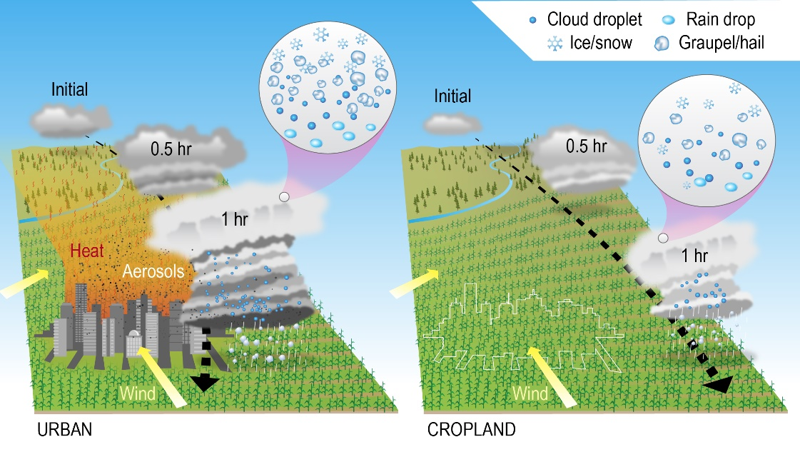
Urbanization Changed Storm Path, Intensified Storm, and Enhanced Large Hail
Objective
Understand how changes in urban land use and anthropogenic aerosols from Kansas City jointly and individually alter severe convective storms and hail.
Approach
Simulate a typical supercell severe convective storm over the central Great Plains using a detailed aerosol, cloud, and urban canopy model (WRF-Chem-SBM with BEP-BEM) and 1-km grid spacing.
Evaluate simulations of radar reflectivity, precipitation, storm path, and hail properties using observations.
Carry out sensitivity tests and then apply a storm-tracking algorithm to track storm movement.
Impact
The urban land effect produces a stronger convective cell and diverts the storm toward the city because of enhanced convergence. The aerosol effect does not change the storm path.
The joint effect enhances occurrences of both severe hail and significant severe hail by ~ 20%. There is a large nonlinear amplification effect in severe hail when both urban land and aerosol effects work together.
The urban land effect (left) initiates a stronger convective cell that gets further intensified, diverting the storm path (black dashed arrow) toward the city. After replacing Kansas City urban land with surrounding cropland (right), the storm is much weaker and its path does not move toward the location of Kansas City. The joint effect of urban land and anthropogenic aerosols from Kansas City leads to more and larger hailstones (left).
Y. Lin, J. Fan, J.-H. Jeong, Y. Zhang, C. R. Homeyer, J. Wang, “Urbanization-induced land and aerosol impacts on storm propagation and hail characteristics.” J. Atmos. Sci., 78, (2021). https://doi.org/10.1175/JAS-D-20-01061

