Slide 1
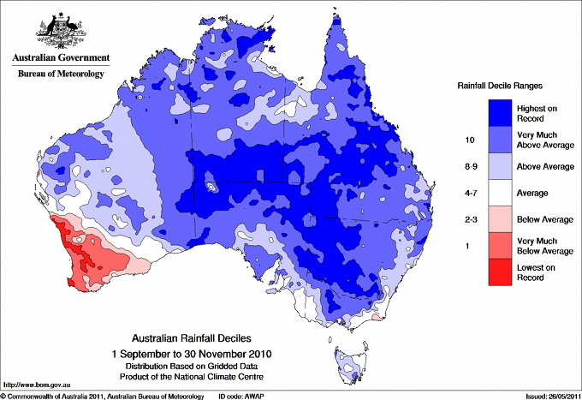
The interaction of the SST trend and La Niña in austral spring 2010
Objective: Australia received record high rainfall in spring 2010 with a strong La Niña being a major driver. Warmer SSTs due to the trend to the north of Australia also contributed to the wet condition. By what mechanism does the SST warming trend interact with La Niña to enhance the rainfall over Australia in spring 2010? Hypothesis: the SST trend enhanced the rainfall over Australia in spring 2010 by strengthening the positive SAM
Approach: using a seasonal forecast system, design and run experiments with & without long-term temperature trend in the ocean initial conditions of 1 Sep 2010 (strong La Niña) and climatology.
Impact: The long term SST trend that operated with La Niña:
Anomalously warm SSTs due to La Niña & -ve IOD and trend
Strong La Niña whose cold SST extended to far west
Wettest spring on record
(since 1910)
+ve Southern Annular Mode (SAM)
-- amplified the wet condition associated with La Niña over the maritime continent and Australia
-- induced +ve SAM, and therefore, increased Australian rainfall
- mechanism of promoting +ve SAM was similar to that of climate change with increasing CO₂ scenarios
The same SST trend that operated with climatological SSTs did not promote +ve SAM response and the impact of the trend on Australia rainfall was small
Lim, EP, HH Hendon, JM Arblaster, C Chung, AF Moise, P Hope, G Young, M Zhao, 2016: Interaction of the recent 50 year SST trend and La Niña 2010: amplification of the Southern Annular Mode and Australian springtime rainfall, Clim. Dyn., in press

