Slide 1
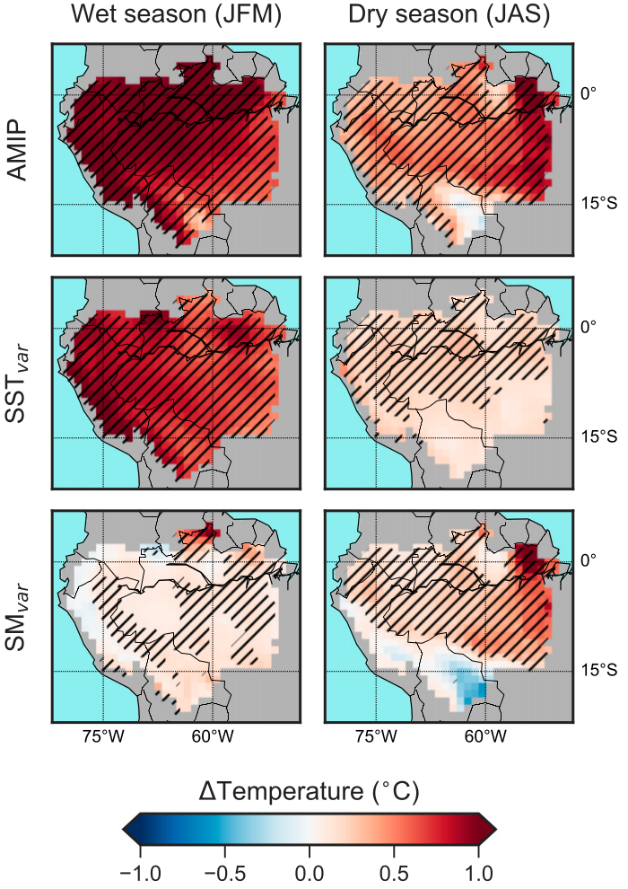
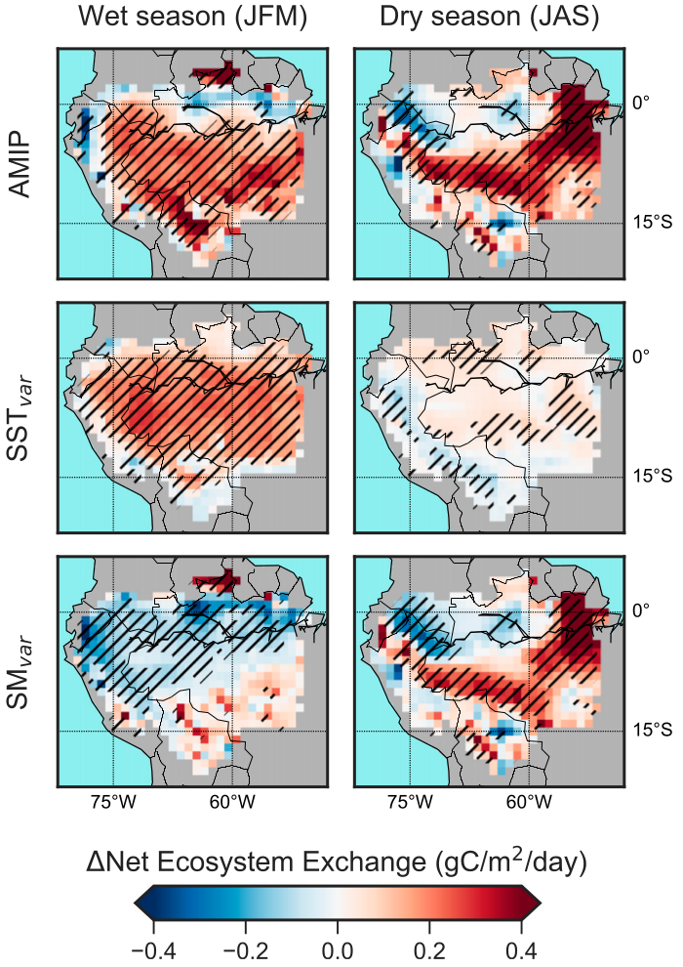
Soil moisture variability intensifies and prolongs eastern Amazon temperature and carbon cycle response to El Niño-Southern Oscillation
a. Temperature
b. Carbon
Objective: To understand how land-atmosphere coupling influences temperature and carbon cycle contrasts between El Niño and La Niña conditions in the Amazon.
Approach: Use the Energy Exascale Earth System Model (E3SM v0.3) to simulate land and atmosphere with observed SSTs (1982–2016). SST_{var}: Soil moisture is fixed to climatology, SSTs vary; SM_{var}: SSTs are fixed to climatology, soil moisture varies.
Results/Impacts: During wet season (January–March), the contrast between El Niño and La Niña is driven by coupled ocean–atmospheric teleconnections. Soil moisture anomalies persist into the subsequent dry season in the eastern Amazon, strengthening and extending temperature and carbon cycle anomalies. This dependence on soil moisture variability could lead offline ecosystem models to overestimate the relative importance of temperature on carbon fluxes.
Figure: a. The difference between the mean temperature anomalies of El Niño years and those of La Niña years. Monthly anomalies are averaged across the wet season (JFM, left column) and dry season (JAS, right column). Each experiment (row) is described in the Approach section of the text. b. Same as a., but for monthly anomalies of net ecosystem exchange (positive is a flux to the atmosphere).
Levine, P. A., J. T. Randerson, Y. Chen, M. S. Pritchard, M. Xu, and F. M. Hoffman (2019), Soil moisture variability intensifies and prolongs eastern Amazon temperature and carbon cycle response to El Niño-Southern Oscillation, J. Clim., 32(4):1273–1292, doi:10.1175/JCLI-D-18-0150.1.

