Slide 1
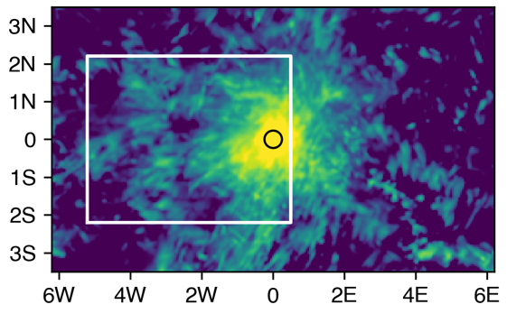
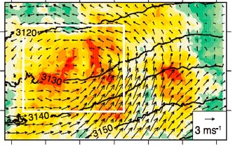
Stronger Storm Systems Linger Longer Over the Central United States
Interactions between MCSs and their large-scale environments: Composites of MCS rainfall, heating, and environment over the central U.S.
Objective
Investigate the large-scale environments conducive to prolonging mesoscale convective systems (MCSs) in the central United States
Approach
Perform convection-permitting regional climate simulations using the Weather Research and Forecasting model over the United States
Evaluate and analyze the simulations by compositing short-, medium-, and long-lived MCSs
Impact
Study revealed that MCSs lasting at least nine hours can modify the environment to prolong their lives
Results suggest that small changes enhancing the large-scale environment favorable for long-lived MCSs may result in a large increase in their frequency because of their positive feedback to the environment
MCS Heating
MCS Rainfall
MCS Center
MCS Environment
Relative location to MCS center
An MCS lasting nine hours or more produces a substantial amount of rainfall (left) and diabatic heating (upper right). The latter produces a anomalous cyclonic circulation (lower right) that feeds dry, cool air to the rear of the MCS region and helps prolong the system’s lifetime.
Yang Q, RA Houze Jr., LR Leung, and Z Feng. 2017. “Environments of Long-Lived Mesoscale Convective Systems Over the Central United States in Convection Permitting Climate Simulations.” Journal of Geophysical Research: Atmospheres 122:13,288-13,307. DOI: 10.1002/2017JD027033
Notes:
Stronger Storm Systems Linger Longer Over Central United States
Simulations show that organized storms lasting at least nine hours can modify the surrounding environment to further extend their longevity.
The Science
Mesoscale convective systems (MCSs)—intermediate-scale thunderstorm clusters lasting up to about 24 hours—are important precipitation producers. They account for 30-70 percent of warm-season (April to August) rainfall between the Rocky Mountains and Mississippi River, and 50-60 percent of tropical rainfall. The increasing frequency of long-lived MCSs in the past 35 years across the U.S. Great Plains motivates the need to understand the environments that favor their development. Analyzing realistic simulations of these systems, researchers at the U.S. Department of Energy’s Pacific Northwest National Laboratory found that MCSs lasting nine hours or more strengthen the cyclonic (counterclockwise) circulation that feeds dry, cool air into the rear of the MCS region. This process increases evaporative cooling and helps maintain the MCS.
The Impact
MCSs tend to not only produce floods, but they carry with them a variety of severe weather phenomena. The finding that MCSs can be “self-sustaining” suggests that model errors in the large-scale environment can greatly limit their ability to simulate long-lived MCSs. Furthermore, small changes in the large-scale environment may result in large changes in the frequency of long-lived MCSs because the changes can be amplified through interactions between the MCSs and their large-scale environment. Hence, understanding how the large-scale environment may change in the future has important implications for predicting future changes in floods and severe weather in the United States.
Summary
Recent research shows that long-lived MCSs over the U.S. Great Plains have become more frequent and produce more extreme rainfall compared to 35 years ago. To better understand interactions between the large-scale environments and MCSs, researchers performed continental-scale, convection-permitting simulations of the 2011 and 2012 warm seasons for analysis. These simulations—conducted using the Weather Research and Forecasting model—realistically reproduced the structure, lifetime, and mean precipitation of MCSs over the central United States. Researchers analyzed the simulations to determine the environmental conditions conducive to generating long-lived MCSs. The simulations showed that MCSs systematically formed over the central Great Plains ahead of a trough in the upper-level westerlies in combination with an enhanced low-level jet bringing moisture from the Gulf of Mexico. These environmental properties at the time of storm initiation were most prominent for the MCSs that persisted at least nine hours. Those MCSs exhibited the strongest feedback to the environment through diabatic heating produced by condensation and precipitation from the MCSs. The feedback produced a midlevel cyclonic circulation near the trailing portion of the MCS. Researchers found that the mesoscale low-pressure center fed dry, cool air into the environment at the rear of the MCS region, increasing evaporative cooling and helping to maintain the MCS.

