Slide 1
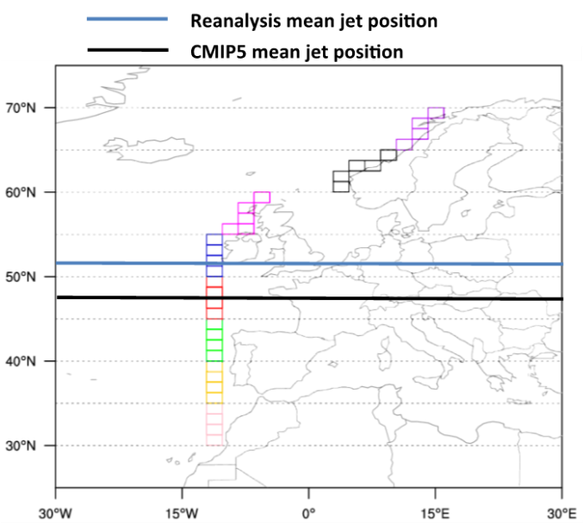
A Survey of Recent Research on Hydroclimatic Variability
Objective
Summarize recent state of-the-science findings regarding large-scale hydrological variability covered during a June 2016 symposium in Princeton, New Jersey
Approach
Survey recent research focusing on: 1) general studies on variability and trends, 2) drought, 3) floods, 4) land-atmosphere coupling, and 5) hydrological prediction
Supplement surveyed topics with illustrative examples of recent research, as presented at the symposium
Impact
Authors highlighted key findings dating from 2010 to the present
Survey provides scientists in the field with multiple starting points for further study of multifaceted water-cycle issues
TOP: Grid boxes (colored) used to detect CMIP5 model-simulated North Atlantic atmospheric rivers (ARs) making landfall in Europe. The CMIP5 models simulate a mean jet stream position (black) that is almost 5 degrees equatorward of that shown in the reanalysis.
BOTTOM: Compared to four global reanalyses, (colored symbols), CMIP5 models simulated too few or too many ARs poleward or equatorward of the observed jet position (vertical black line) in the North Atlantic.
Koster RD, AK Betts, PA Dirmeyer, M Bierkens, KE Bennett, S Dery, JP Evans, R Fu, F Hernandez, LR Leung, X Liang, M Masood, H Savenije, G Wang, and X Yuan. 2017. “Hydroclimatic Variability and Predictability: A Survey of Recent Research.” Hydrology and Earth System Sciences 21:3777-3798. DOI: 10.5194/hess-21-3777-2017
Notes:
http://www.pnnl.gov/science/highlights/highlights.asp?division=749

