Slide 1
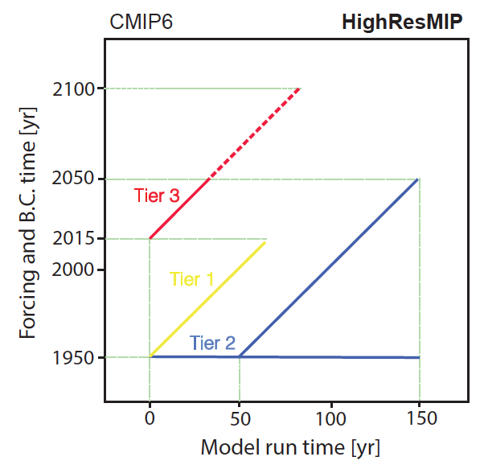
High Resolution Model Intercomparison Project (HighResMIP) for CMIP6
Schematic outline of Tiers 1, 2, and 3 simulations
Objective
Describe the design of an international project called HighResMIP that aims at systematically evaluating the impacts of model horizontal resolution on climate simulation fidelity
Approach
Design a coordinated set of experiments in HighResMIP to assess atmosphere and ocean simulations at both standard and enhanced horizontal-resolutions
Divide the experiments into three tiers consisting of atmosphere-only and coupled runs, and spanning the period 1950–2050, with the possibility of extending to 2100
Compare simulations from the multi-model ensemble that follows the experimental protocol to assess the robust response of simulated climate to model resolution
Impact
A systematic evaluation of the impacts of model resolution using a multi-model approach has important implications to understanding uncertainty in model projections of regional climate change, water availability, and regional sea level rise
Haarsma RJ, M Roberts, PL Vidale, CA Senior, A Bellucci, Q Bao, P Chang, S Corti, NS Fučkar, V Guemas, J von Hardenberg, W Hazeleger, C Kodama, T Koenigk, LR Leung, J Lu, J-J Luo, J Mao, M Mizielinski, R Mizuta, P Nobre, M Satoh, E Scoccimarro, T Semmler, J Small, and J-S von Storch. 2016. “High Resolution Model Intercomparison Project (HighResMIP v1.0) for CMIP6.” Geoscientific Model Development 9:4185-4208. DOI:10.5194/gmd-9-4185-2016
Notes:
http://www.pnnl.gov/science/highlights/highlights.asp?division=749

