Slide 1
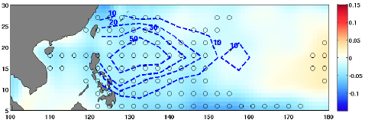
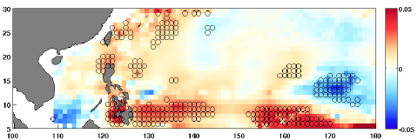
Global Warming-induced Upper-ocean Freshening and the Intensification of Super Typhoons
Objective
Estimate the impact of changes in upper-ocean salinity stratification on the intensification of super typhoons over the past 50 years using observations.
Project future changes in super typhoon intensities due to changes in salinity using climate models.
Approach
Separate the effect of salinity stratification from temperature on super typhoon intensities using the framework of Dynamic Potential Intensity (DPI)
Compute trends in DPI using ocean sub-surface data from four different ocean reanalysis products (EN4, GFDL, ORAS4, SODA) along with atmospheric data from NCEP reanalysis for the period 1961-2008.
Compute 100-year changes in DPI under the RCP 8.5 climate change scenario using 18 CMIP5 climate models.
Upper panel: Decreasing trends (blue shading) in typhoon-season (June-Nov) mean sea surface salinity (psu decade⁻¹) for 1958-2013 in the northwestern tropical Pacific, which has the highest frequency of super typhoons (blue dashed-contours represent the number of 6-hourly super typhoon locations). Lower panel: Reduced salinity reduces tropical cyclone-induced cold wakes (red shading in ºC decade⁻¹) so super typhoons tend to intensify.
Impact
Provided observational evidence that in the northwestern Pacific, changes in salinity caused by an increase in freshening that tends to intensify super typhoons overwhelms the suppressive effects of ocean thermal structure changes
Demonstrated that in future climate model projections, salinity changes negate about 50-60% of the suppressive effects due to temperature.
Balaguru K, GR Foltz, LR Leung, and KA Emanuel. 2016. “Global Warming-Induced Upper-ocean Freshening and the Intensification of Super Typhoons.” Nature Communications 7:13670. DOI: 10.1038/ncomms13670
Notes:
http://www.pnnl.gov/science/highlights/highlights.asp?division=749

