Slide 1
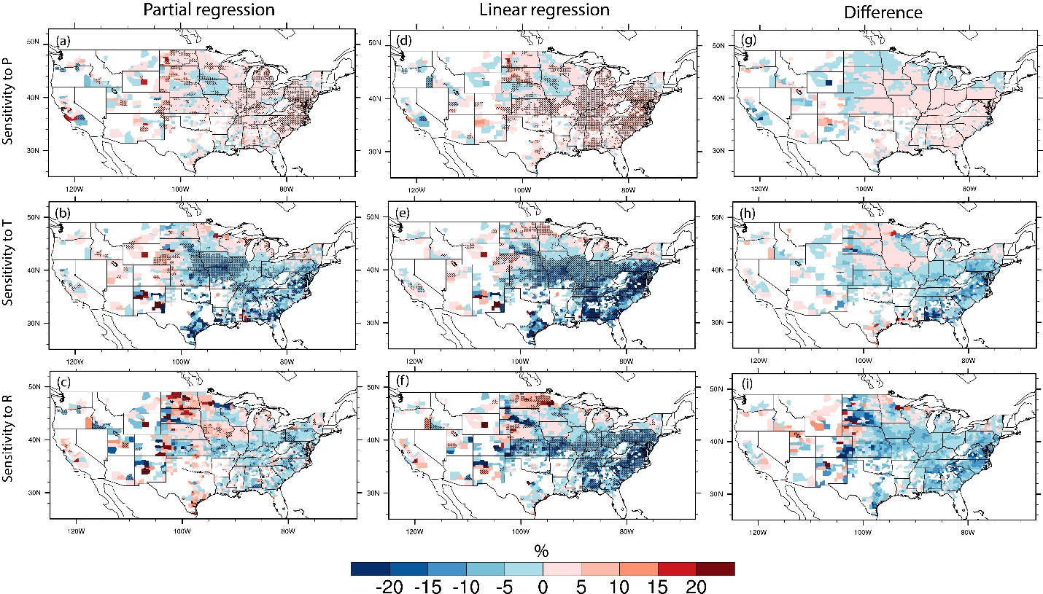
Considering Climate Covariability in Assessing Climate Impacts on Bioenergy Crop Yields
Objective
Investigate climate impacts on historical bioenergy crop yields, including the role of covariability among weather variables
Approach
Obtain county level yields of two major bioenergy crops (i.e. corn and soybean) from USDA
Aggregate precipitation, temperature and radiation data from North America Land Data Assimilation System to county level
Develop statistical modeling to link county-level climate and biomass yields for 1983-2012
Use Partial Least Squares Regression to estimate yield sensitivity to individual climate factors excluding covariability
Without climate covariability
With climate covariability
Difference
Changes (%) in yields of corn with one unit increase of precipitation (top), temperature (middle) and radiation (bottom) for each growing county
Impact
Established the importance of climate covariability in modulating climate impacts on bioenergy crop yields
Revealed which climate variables have dominated historical yield impacts in each crop-growing county
Advanced insights on the increasingly debated question of whether climate change leads to a net loss or gain for bioenergy crop yields in temperate regions
Found that regions using irrigation have been more resilient to historical climate change, suggesting possible increases in future water use for crop production
Leng G, X Zhang, M Huang, GR Asrar, and LR Leung. “The Role of Climate Covariability on Crop Yields in the Conterminous United States.” Scientific Reports 6:33160. DOI: 10.1038/srep33160
Notes:
http://www.pnnl.gov/science/highlights/highlights.asp?division=749

