Slide 1
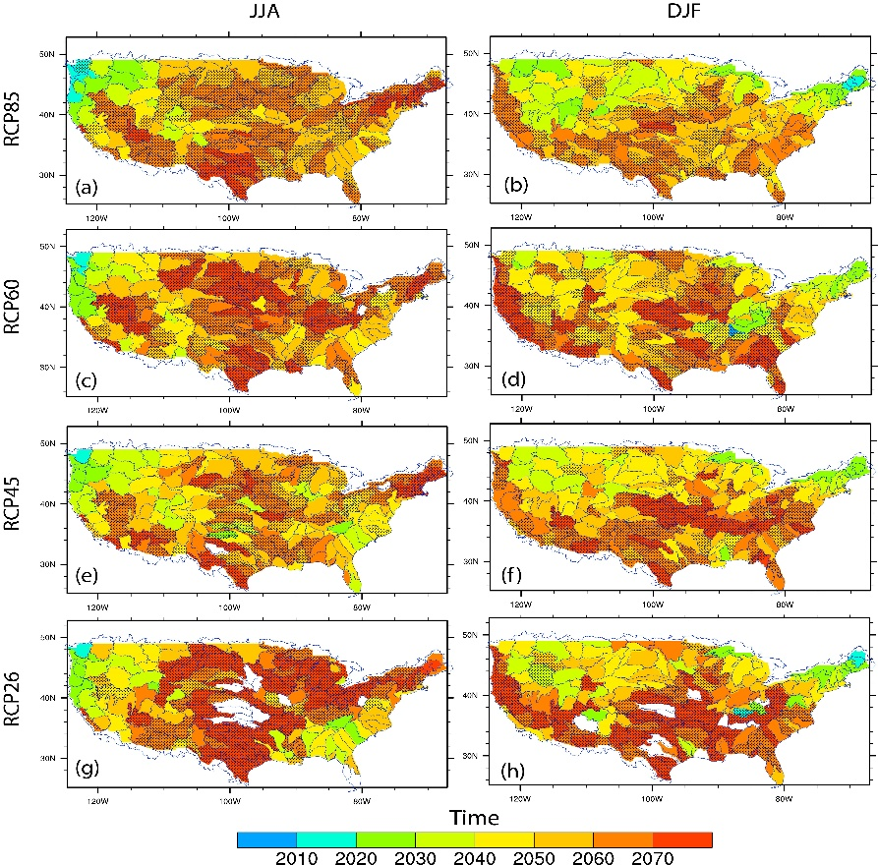
New Hydrologic Regimes to Emerge in the Near Future in the United States
Objective
Detect the emergence of new US hydrologic regimes, link such emergence directly to global temperature scenarios, and tie emergence to changes in the mean or variability, and other statistical moments.
Approach
Analyze 97 high resolution CMIP5 hydro-climate projections
Detect the emergence of new hydrologic regime in each basin by applying the Kolmogorov–Smirnov test
Design pseudo scenarios to decompose statistical moments
Construct the empirical relationship between such emergence and global warming amount
Time of emergence of new regime for summer (June-July-August, JJA) and winter (December-January-February, DJF) surface hydrology at the HUC4 sub-basin level.
Impact
More than 40% of the land area will experience the emergence of new hydrological regimes by the end of the 21st century, and such shifts in Northern California and the Pacific Northwest are projected to occur in the 2030.
Such emergence scales with global warming amount at the CONUS scale, independent of emission scenarios.
The emergence of new hydrology regimes is dominated by the changes in variability rather than shift in the mean.
Leng G, M Huang, N Voisin, X Zhang, G Asrar, LR Leung. 2016. “Emergence of New Hydrologic Regimes of Surface Water Resources in the Conterminous United States under Future Warming.” Environmental Research Letters 11(11): 114003. DOI:10.1088/1748-9326/11/11/114003
Notes:
http://www.pnnl.gov/science/highlights/highlights.asp?division=749

