Slide 1
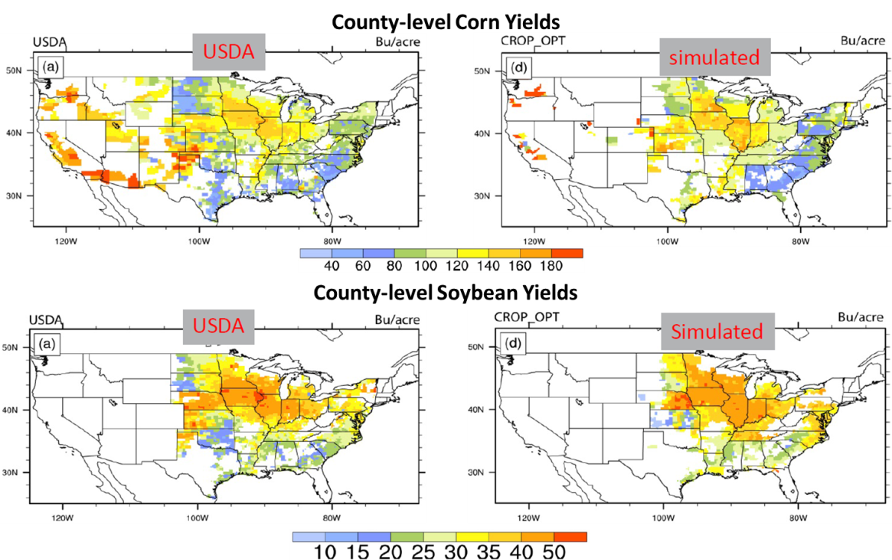
A Prognostic Fertilization Design for Modeling Agriculture in the Earth System
Objective
Improve the capability of simulating U.S. bioenergy crop yields
Approach
Build a geo-spatial database on crop type, area and yields, fertilizer amount, and irrigation amount from available observations
Set up the Community Land Model (CLM4.5) at the 0.125 degree resolution in the United States
Validate the simulated crop yields from CLM4.5 against census data at the county level
Incorporate a prognostic fertilization parameterization that dynamically determines the timing and rate of each fertilizer application to improve crop yield simulations.
County-level bioenergy crop simulations are significantly improved using the proposed parameterization
Impact
In the default model, the bias in simulating corn and soybean yields is up to 42% and 38% as measured by county-level root-mean-square error (RMSE)
The new fertilization parameterization, constrained by census data, reduces the RMSE to 22% and 21% of the U.S. mean corn and soybean yields, respectively.
Leng G, X Zhang, M Huang, Q Yang, R Rafique, GR Asrar and LR Leung. 2016. “Simulating County-level Crop Yields in the Conterminous United States using the Community Land Model: The Effects of Optimizing Irrigation and Fertilization.” Journal of Advances in Modeling Earth Systems, 08. DOI: 10.1002/2016MS000645
Notes:
http://www.pnnl.gov/science/highlights/highlights.asp?division=749

