Slide 1
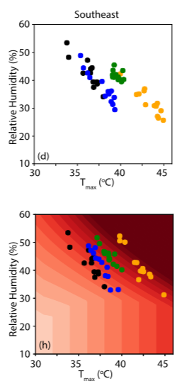
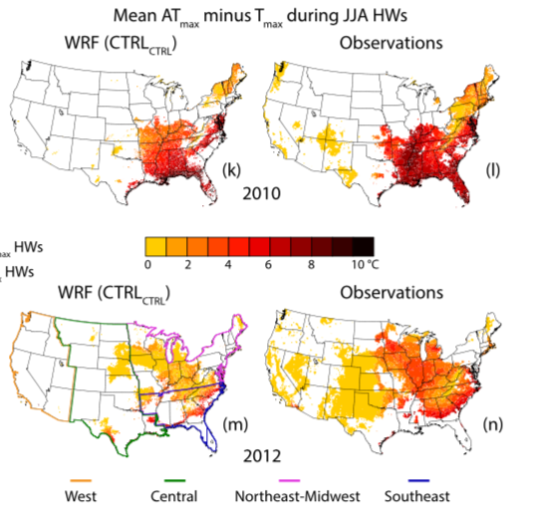


Revisiting recent U.S. heat waves in a warmer and more humid climate
Deeksha Rastogi, Flavio Lehner, Moetasim Ashfaq:
Geophysical Research Letters, 47, e2019GL086736 (2020) doi:10.1029/2019GL086736
OBJECTIVE
Determine the role of thermodynamically-driven humidity changes for future heat waves and heat stress over the U.S.
APPROACH
High resolution WRF simulation with atmospheric circulation nudged towards reanalysis in a current and future climate state. Benefit: historically observed heat waves reoccur in the future and enable a direct comparison.
IMPACT
Dry heat waves become drier, and humid heat waves stay humid in a warmer climate, showing temperature‐driven increase in future heat stress.
Results suggest thermodynamic drivers dominate future changes in characteristics of both dry and humid heat waves.

