Slide 1
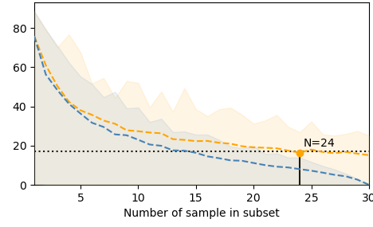
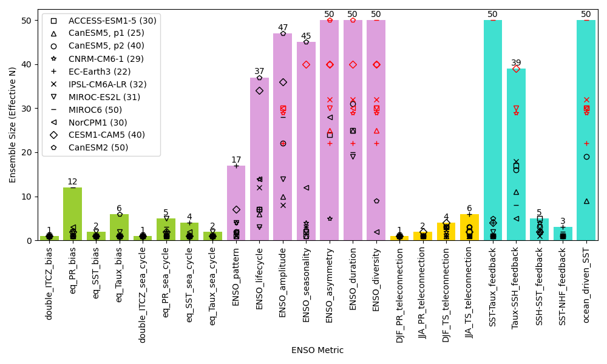

Estimate Ensemble Size for Robust ENSO evaluation in climate models
Scientific Achievement
To estimate the ensemble size required to characterize the ENSO simulation, ensemble members of CMIP6 and Large Ensemble models are analyzed.
A broad range in the relative performance of models exists with internal variability influencing the robustness of some ENSO characteristics.
The required ensemble size depends on metric, duration of observational record, and model; the size can be a small as 6 or greater than 50.
Research summary
Large ensembles of model simulations require considerable resources, and thus defining an appropriate ensemble size for a particular application is an important experimental design criterion. We estimate the ensemble size (N) needed to assess a model's ability to capture observed El Niño-Southern Oscillation (ENSO) behavior by utilizing the recently developed International CLIVAR ENSO Metrics Package (Planton et al., 2021). Using the larger ensembles available from CMIP6 and the US CLIVAR Large Ensemble Working Group, we find that larger ensembles are needed to robustly capture baseline ENSO characteristics (N > 50) and physical processes (N > 50) than the background climatology (N ≥ 12) and remote ENSO teleconnections (N ≥ 6). While these results vary somewhat across metrics and models, our study quantifies how larger ensembles are required to robustly evaluate simulated ENSO behavior, thereby providing some guidance for the design of model ensembles.
ENSO Asymmetry (e.g. IPSL-CM6-1, 30 members)
Diff. from entire
ensemble mean
Significance & Impact
To account for uncertainties arising from the chaotic nature of the climate system, Earth system models are often used to generate a large number of simulations under slightly different initial conditions. These large ensembles enable the consistency between models and observations to be addressed while accounting for the internal variability in the climate system. Creating a set of ensemble simulations requires substantial resources, and so in this study we diagnose what ensemble size is sufficient to robustly represent the simulated behavior of the El Niño / Southern Oscillation (ENSO), one of the most important modes of variability affecting climate worldwide.
background climatology
baseline ENSO characteristics
teleconnections
physical processes
Lee, Jiwoo., Y. Planton, Peter Gleckler, Kenneth Sperber, E. Guilyardi, A. T. Wittenberg, M. J. McPhaden, and Giuliana Pallotta, 2021: Robust evaluation of ENSO in climate models: How many ensemble members are needed? Geophysical Research Letter, https://doi.org/10.1029/2021GL095041

