Slide 1
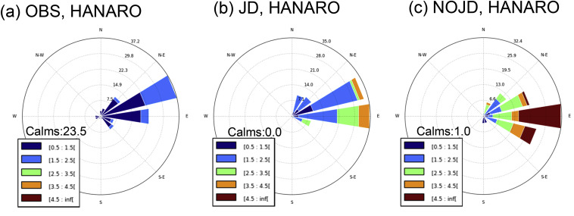
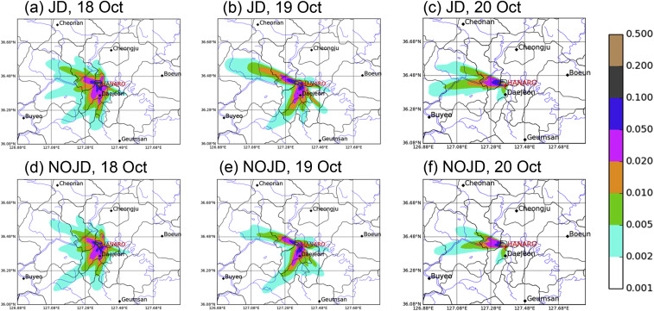
Impact of boundary layer simulation on predicting radioactive pollutant dispersion
Scientific Achievement The results highlight the importance of considering the orographic drag in the simulation, especially over domains having complex topography, when predicting distribution of radioactive pollutant concentration in case of its accidental release.
Significance & Impact
The objective of the study is to improve the accuracy of the radioactive dispersion prediction from the WRF-MMIF-CALPUFF modeling system by investigating the impact of the boundary layer simulation.
Research summary
The numerical simulations were conducted using the WRF-based dispersion modeling system and the influence of different methods for calculating PBL-related factors in the WRF model upon the wind prediction and corresponding dispersion of the radioactive material (137Cs) was examined.
Comparing observed and simulated wind direction and intensity at the radioactive pollutant releasing location.
Comparison of simulated spatial distribution of radioactive pollutant concentration with varying methods for surface wind.
Lim, K.-S. S., J.-M. Lim, Jiwoo Lee, and H. H. Shin, 2021: Impact of boundary layer simulation on predicting radioactive pollutant dispersion: a case study for HANARO Research Reactor using the WRF-MMIF-CALPUFF modeling system. Nuclear Engineering and Technology, 53, 244-252, doi: 10.1016/j.net.2020.06.011

