Slide 1
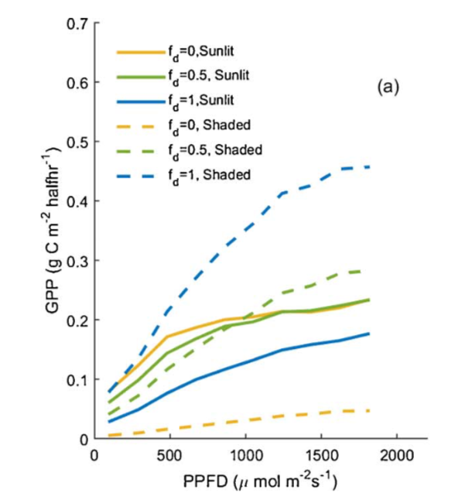
Model-based analysis of the impact of diffuse radiation on CO₂ exchange in a temperate deciduous forest
Scientific Achievement
We highlight a large sensitivity of carbon uptake to diffuse fraction
Largest sensitivity at low diffuse fractions
Biases in existing radiative transfer models imply needed model improvements
Significance and Impact
Temperate forest carbon cycling is critical for global predictions of the terrestrial C cycle
We used observations to examine the role of changes in the diffuse fraction of light on forest carbon cycling
We showed that current radiative transfer models exhibit large biases that translate to biased carbon cycle predictions
Figure. Modeled photosynthesis (GPP) under different levels of diffuse fraction (0, 0.5, 1) for sunlight and shaded leaves in a closed canopy forest in the northeastern US.
Research Details
We combined 10 years of eddy-covariance and ancillary measurements from Bartlett Experimental Forest with a parsimonious process-based model of the terrestrial carbon cycle, and two radiative transfer models, to assess the impact of diffuse radiation on forest ecosystem carbon cycling.
Lee, S., Hollinger, D., Keenan, T., Ouimette, A., Ollinger, S., Richardson, A. Model-based analysis of the impact of diffuse radiation on CO2 exchange in a temperate deciduous forest, Agricultural and Forest Meteorology, 249, doi: 10.1016/j.agrformet.2017.11.016 (2018).

