Slide 1
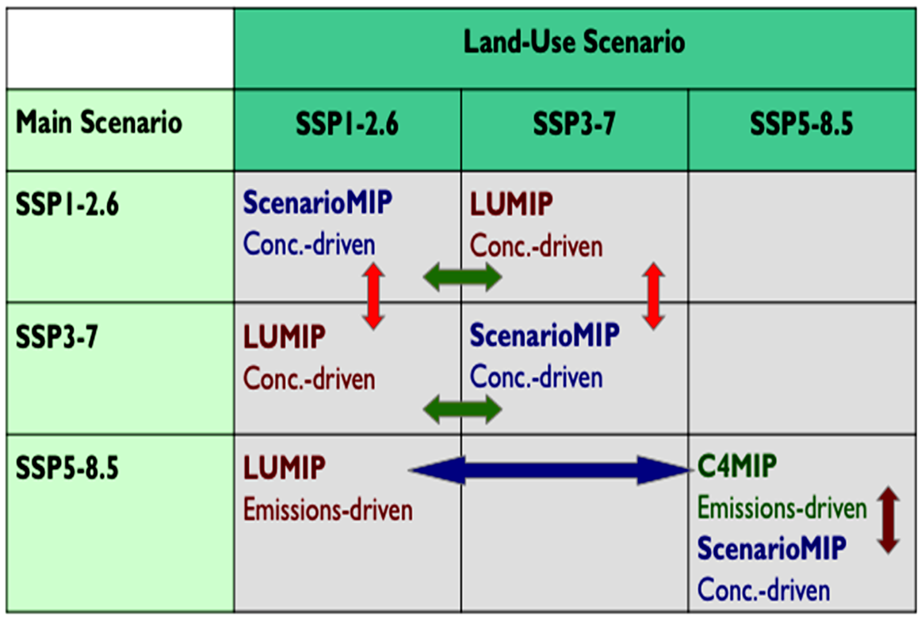
The Land Use Model Intercomparison Project (LUMIP) contribution to CMIP6: rationale and experimental design
Objective: LUMIP aims to advance understanding of the impacts of land-use and land-cover change (LULCC) on climate, addressing the following questions:
(1) What are the effects of LULCC on climate and biogeochemical cycling?
(2) What are impacts of land management on fluxes of carbon, water, and energy, and are there regional land-management strategies with promise to help mitigate climate change?
Additional foci on separation and quantification of LULCC impacts relative to all forcings, separation of biogeochemical from biogeophysical LULCC effects, the unique impacts of land-cover change vs. land-management change, modulation of land-use impact on climate by land–atmosphere coupling strength, and the extent to which CO₂ fertilization is modulated by past and future land use.
Approach: LUMIP expts will be carried out by modeling centers starting in 2017 and in conjunction with other CMIP6 MIPs. Coupled and land-only expts are included in the design as well as new land use tile output data requests.
Lawrence, D.M., G.C. Hurtt, A. Arneth, V. Brovkin, K.V. Calvin, A.D. Jones, C.D. Jones, P.J. Lawrence, N. de Noblet-Ducoudre, J. Pongratz, S.I. Seneviratne, and E. Shevliakova, 2016: The Land Use Model Intercomparison Project (LUMIP) contribution to CMIP6: Rationale and experimental design. GMD, 9, doi:10.5194/gmd-9-2973-2016.

