Slide 1
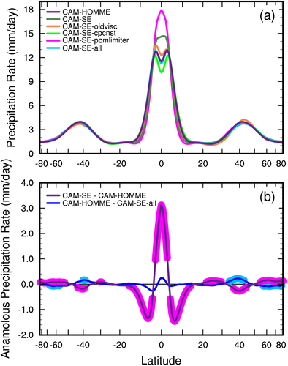
NCAR Release of CAM‐SE in CESM2.0: A Reformulation of the Spectral Element Dynamical Core in Dry‐Mass Vertical Coordinates With Comprehensive Treatment of Condensates and Energy
P.H. Lauritzen, R.D. Nair, A.R. Herrington, P. Callaghan, S. Goldhaber, J.M. Dennis, J.T. Bacmeister, B.E. Eaton, C. M. Zarzycki, Mark A. Taylor, P. A. Ullrich, T. Dubos, A. Gettelman, R. B. Neale, B. Dobbins, K. A. Reed, C. Hannay, B. Medeiros, J.J. Benedict, J.J. Tribbia JAMES, 10.1029/2017MS001257
Objective
Provides a comprehensive documentation of the new NCAR version of the spectral element (SE) dynamical core as part of the Community Earth System Model version 2 release.
Approach
Vertical coordinate now based on dry mass.
Condensates are dynamically active (condensate loading).
Better energy conservation.
Updated hyperviscosity and remapping algorithms.
Impact
CAM-SE has been separated from HOMME and major improvements in the formulation are introduced. The code base is smaller and runs faster. This paper details the changes from the previous version, including idealized moist baroclinic wave and aquaplanet tests.
(a) The zonally averaged total precipitation rates in the aquaplanet simulations, averaged over the final 4 years of a 4.5-year simulation. (b) The change in the total precipitation rate between two simulations denoted by the label. The shading indicates where the differences are significant at the 95% confidence level.

