Slide 1
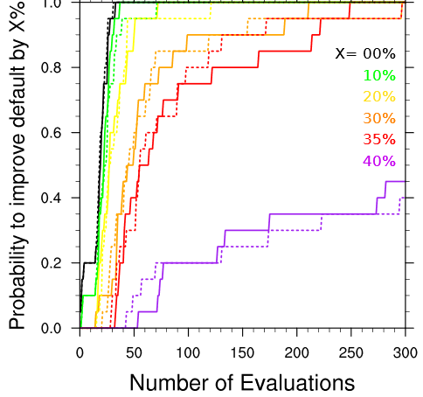
Optimization of the Eddy-Diffusivity shallow-cumulus and boundary-layer parameterization using surrogate models
Surrogate models based on Radial Basis Functions have been applied to optimize a parameterization of the boundary-layer and shallow cumulus clouds.
This is the first time RBF surrogate models have been used to optimize a physics parameterization in a global climate or weather model. Results indicate the potential for this strategy to be applied more widely in atmospheric modeling.
Probability to improve the default setting by X% as a function of the number of model evaluations. Dashed and solid lines indicate different surrogate models.
Surrogate models based on RBFs iteratively refine the cost function describing the model behavior in parameter space.
A comparison against a commonly used quadratic polynomial model is provided
The optimal parameter combinations found for this particular parameterization are described
W. Langhans, J. Muller, W. D. Collins, “Optimization of the Eddy-Diffusivity shallow-cumulus and boundary-layer parameterization using surrogate models.” J. Adv. Model. Earth Syst. 11(2019). [10.1029/2018MS001449].

