Slide 1
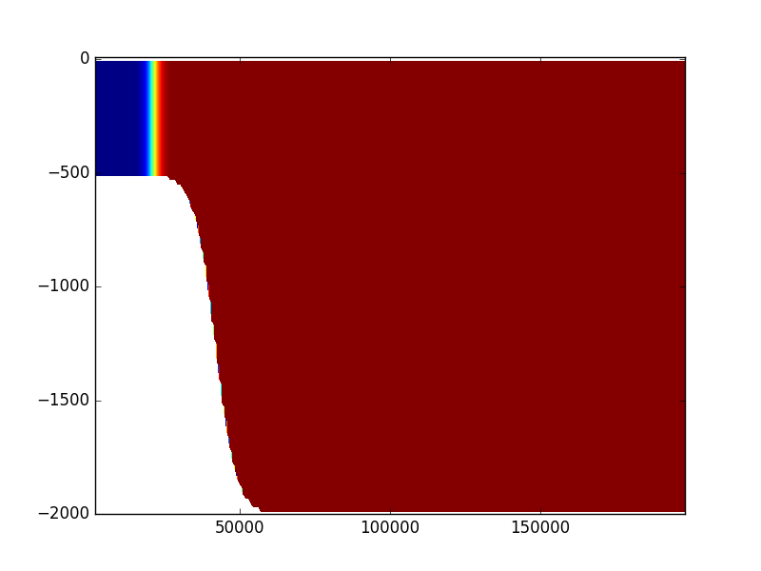
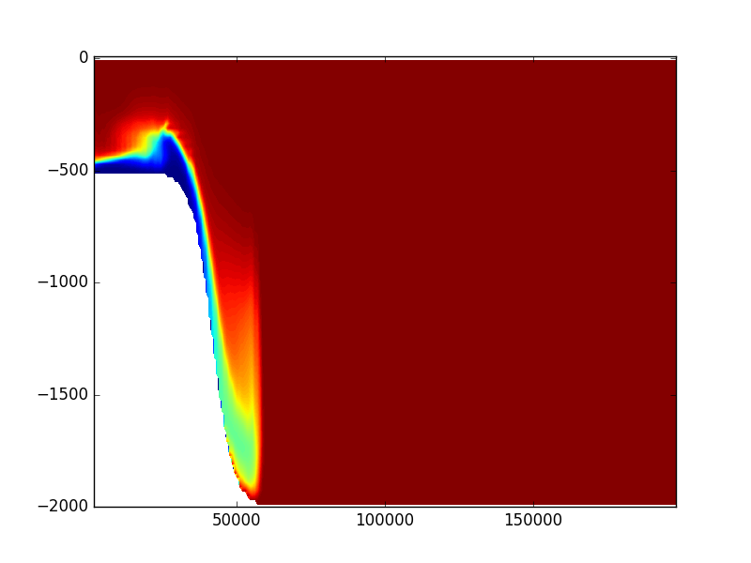
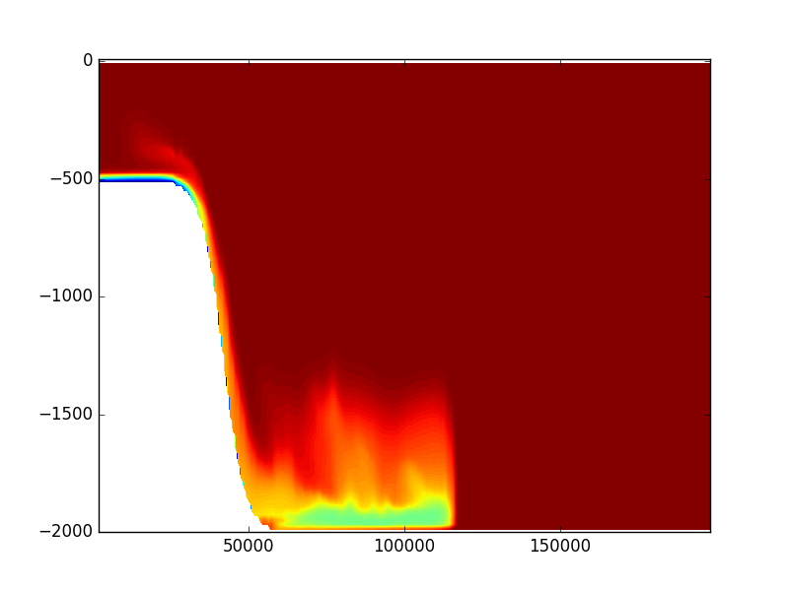

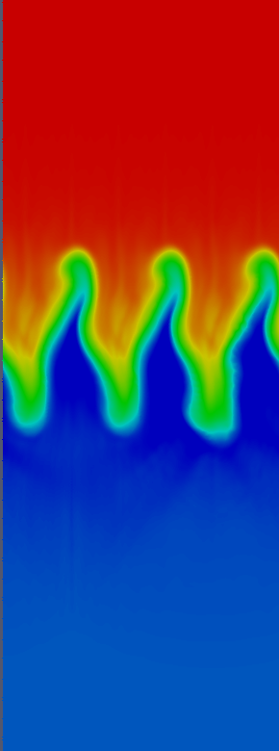
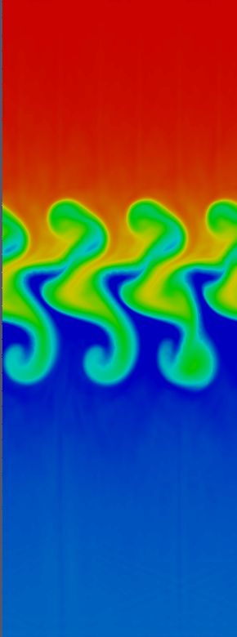
CDG in MPAS-Ocean
Objective
Implement the Characteristic Discontinuous Galerkin scheme for passive tracer transport in MPAS-Ocean.
3D transport on Voronoi grid in horizontal and arbitrary Lagrangian-Eulerian (ALE) grid in vertical.
Preserve consistency of volume fluxes with respect to dynamics.
Research
Solve the 3D transport equation using CDG on unstructured mesh in horizontal and moving vertical mesh.
Rescaling of fluxes by continuity equation to preserve consistency.
Investigate limiting strategies for preserving monotonicity with minimal diffusion (ongoing & future work).
Impact
Preserves conservation, monotonicity and consistency for passive tracer subject to dynamic velocity and mesh.
Reference: Lee, Petersen, Lowrie, and Ringler, “Tracer Transport within an Unstructured Grid Ocean Model using Characteristic Discontinuous Galerkin Advection”, submitted to Computers and Mathematics with Applications.
Notes:
<number>

