Slide 1
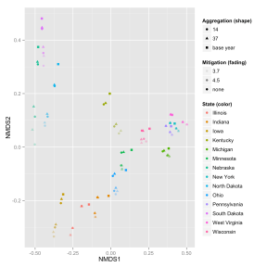
Application of Multi-Variate Statistical Methods to Land-Use Modeling Expands the Scope of Analysis
Objective
Find impact of spatial scales on modeling land-use in PNNL’s Global Change Assessment Model (GCAM), an integrated assessment model
Quantify and visualize land-use responses across a range of modeled drivers using a new analysis technique
Approach
Process land-use data in Midwestern U.S. pilot region at three different spatial scales
Analyze scale-related responses in scenarios in GCAM
Apply non-metric, multi-dimensional scaling (NMDS) to quantify and visualize responses across all modeled land-use types
Differences in land allocation by 8 land-use types, 14 states, and any number of scenarios or time periods are collapsed into two-dimensional coordinate planes for analysis
Impact
The research found that Midwestern U.S. states are an appropriate size for GCAM land-use regions
The NMDS method captures land-use responses across a set of regions and land-use types in a more complete and succinct fashion than analysis focused on individual regions or land-use types
Kyle P, AM Thomson, MA Wise, and X Zhang. 2015. “Assessment of the Importance of Spatial Scale in Long-Term Land Use Modeling of the Midwestern United States.” Environmental Modelling and Software, in press. DOI: 10.1016/j.envsoft.2015.06.006.
Notes:
http://www.pnnl.gov/science/highlights/highlights.asp?division=749

