Slide 1
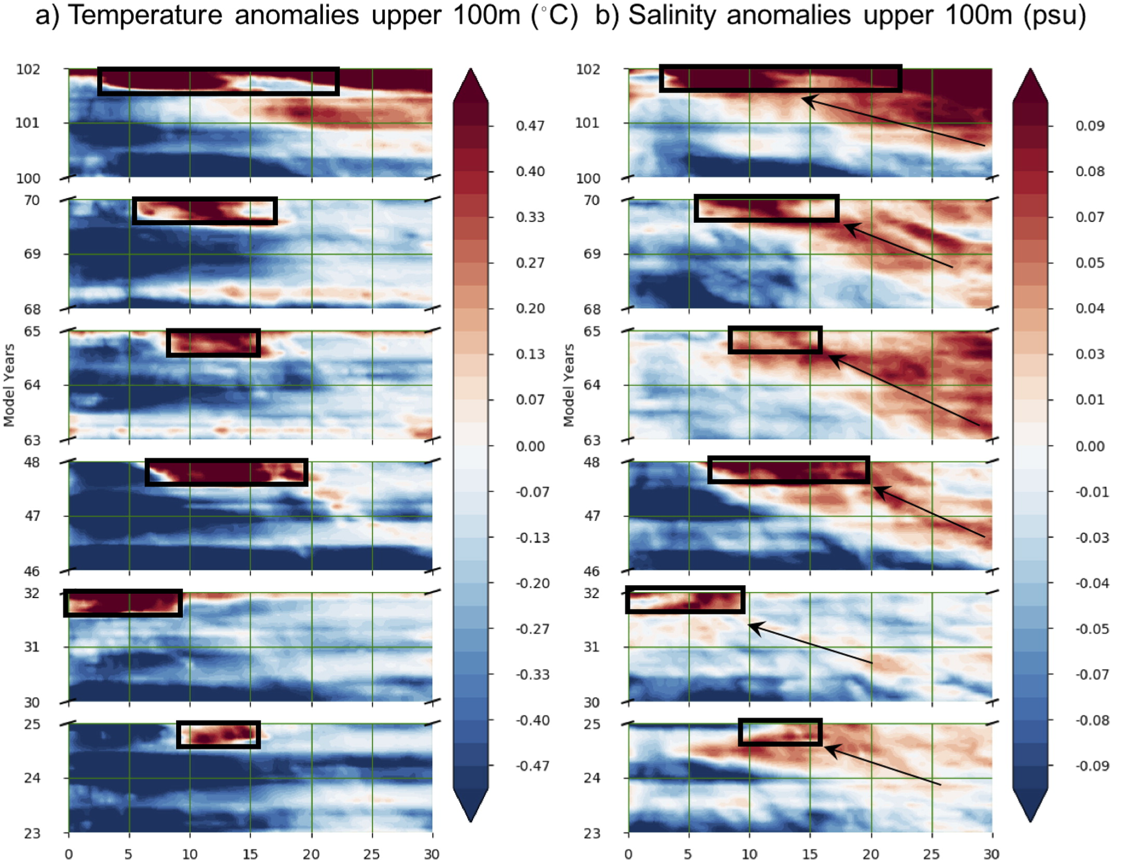
Preconditioning and Formation of Maud Rise Polynyas in a High-Resolution Earth System Model
Objectives
Study the processes that precondition the Weddell Sea for the formation of Maud Rise polynyas (MRPs)
Identify the processes that trigger the formation of MRPs
Approach
Analyze output from a high-resolution coupled Earth System Model (ESM), namely E3SMv0-HR.
Composite difference in mixed layer depth (a,b) and sea ice concentration (c,d) for years without (a,c) and with (b,d) Maud Rise polynyas. Black contours indicate bathymetry, while the white contour marks the 65% mean ice concentration level.
Impact
High-resolution representation of bathymetry and its interaction with ocean circulation is critical for preconditioning and triggering MRPs
Sea surface salinity anomalies are also very important for triggering the polynyas
Zonal eveolution of upper ocean temperature (a) and salinity (b) anomalies around the Maud Rise region. Westward propagation of salinity anomalies into the polynya region can be seen in (b).
Kurtakoti, P., M. Veneziani, A. Stössel, and W. Weijer, 2018. Preconditioning and Formation of Maud Rise Polynyas in a High-Resolution Earth System Model. Journal of Climate, 31(23), pp. 9659-9678.

