Slide 1
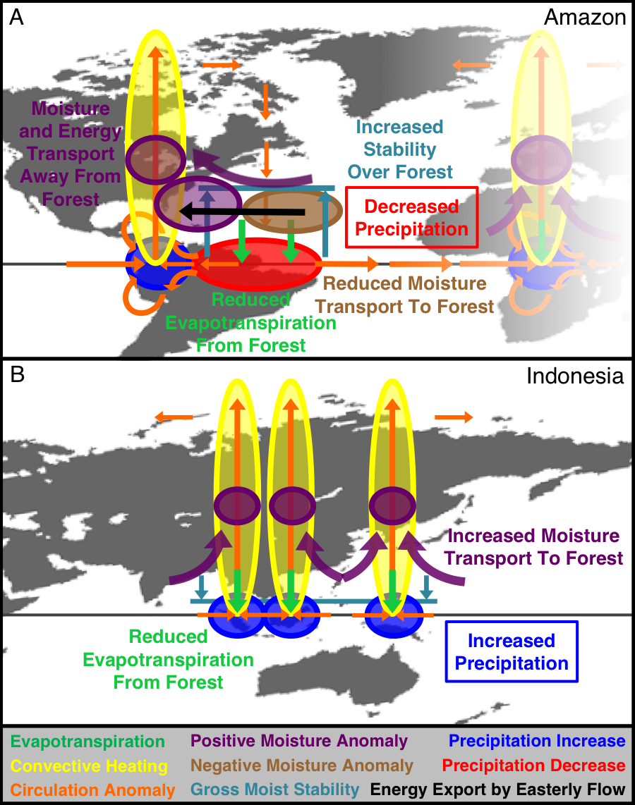
Forest response to rising CO₂ drives zonally asymmetric rainfall change over tropical land
Objective: To understand why climate model projections indicate some tropical land areas will get drier and others will get wetter.
Approach: Conduct experiments with the Community Earth System Model (v1) to identify how the direct physiological effect of rising CO₂ influences rainfall on different tropical continents.
Results/Impacts: The influence of rising CO₂ on tropical forests reduces rainfall in South America, and surprisingly, causes more rainfall in African and Asian forests. This is because changes in the surface energy budget excite different and unique atmospheric circulation responses over each continent.
Kooperman, G. J., Y. Chen, F. M. Hoffman, C. D. Koven, K. Lindsay, M. S. Pritchard, A. L. S. Swann, and J. T. Randerson (2018), Forest response to rising CO₂ drives zonally asymmetric rainfall change over tropical land, Nature Clim. Change, doi:10.1038/s41558-018-0144-7.
Figure: This diagram shows how decreases in future evapotranspiration may trigger suppression of convection and rainfall in the lowland Amazon, but entrainment of more humid ocean air over islands in tropical Asia.

