Slide 1
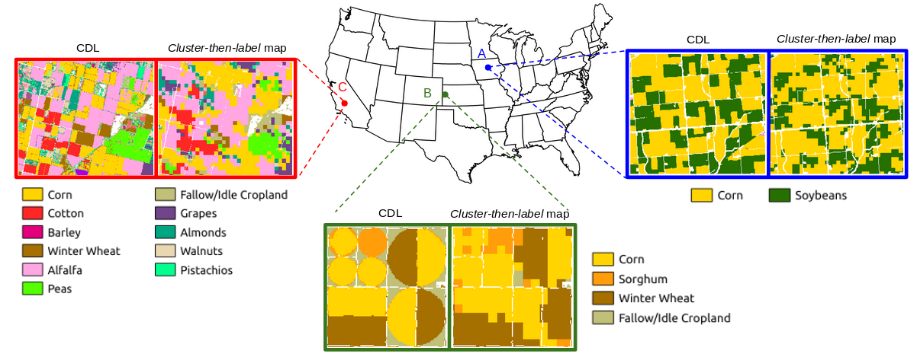
Satellite Data Analytics Enables Within-Season Crop Identification
a)
Objective: Map crops in the Continental US before harvest and determine earliest date of accurate classification
Approach: Train a semi-supervised classifier with prior USDA Crop Data Layer (CDL) products and MODIS satellite NDVI data, then classify within-season MODIS observations
Results/Impacts: Classifier was trained by clustering NDVI data and assigning CDL crop labels to resulting phenoregions within separately derived ecoregions. Pixel-wise accuracy for eight major crops by area was ~70% across corn-, soybean-, and winter wheat-producing areas. Accuracy for dominant crops improved over the growing season, reaching 90% of year-end accuracy by the end of August. Method enables near real-time monitoring of crop health and could inform commodity yield estimates.
b)
Figure: a) Comparison of cluster-then-label crop map with USDA Crop Data Layer (CDL) shows similar patterns at continental scale. b) Good spatial agreement is found at three selected regions, but cluster-then-label crop maps lack sharpness at field boundaries due to coarser resolution of MODIS data.
Konduri, V. Shashank, Jitendra Kumar, W. W. Hargrove, Forrest M. Hoffman, and A. R. Ganguly (2020), Mapping Crops Within the Growing Season Across the United States, Remote Sens. Environ., 251, 112048, doi:10.1016/j.rse.2020.112048.

