Slide 1
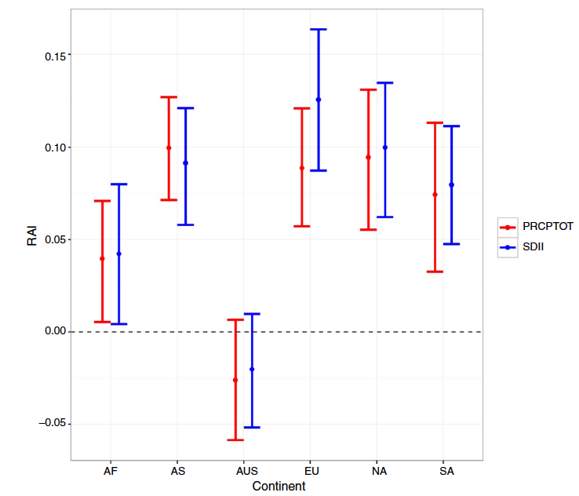
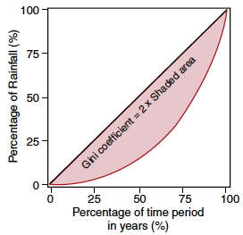
Human Activities Result in Changes in Temporal Variability of Annual Precipitation Over Land
Objective
Determine the contributions of human activities to changes in temporal variability of annual precipitation amount and intensity
Approach
Quantify the disparity of annual precipitation amount and intensity using a statistical metric of dispersion called the Gini coefficient
Calculate the Gini coefficient from a multi-model ensemble of global simulations of the historical climate for 1950−2005 with and without human-caused forcings
Analyze the Relative Anthropogenic Index (RAI), defined as the relative difference of the Gini coefficients calculated from simulations with and without human-caused forcings at global, continental, and subcontinental scales
Left: Explanation of the Gini coefficient for temporal variability.
Right: RAI estimates of mean precipitation amount (red) and intensity (blue) from spatial averages over continents (AF: Africa; AS: Asia; AUS: Australia; EU: Europe; NA: North America; SA: South America), which show that human activities increase precipitation disparity in all continents except Australia.
Impact
This study found that human activities have changed not only the trends, but also the temporal variability of annual precipitation, which underscores the need to develop effective adaptation management practices to address the increased precipitation disparity
Konapala G, A Mishra, and LR Leung. 2017. “Changes in Temporal Variability of Precipitation Over Land due to Anthropogenic Forcings.” Environmental Research Letters 12. DOI: 10.1088/1748-9326/aa568a
Notes:
http://www.pnnl.gov/science/highlights/highlights.asp?division=749

