Slide 1
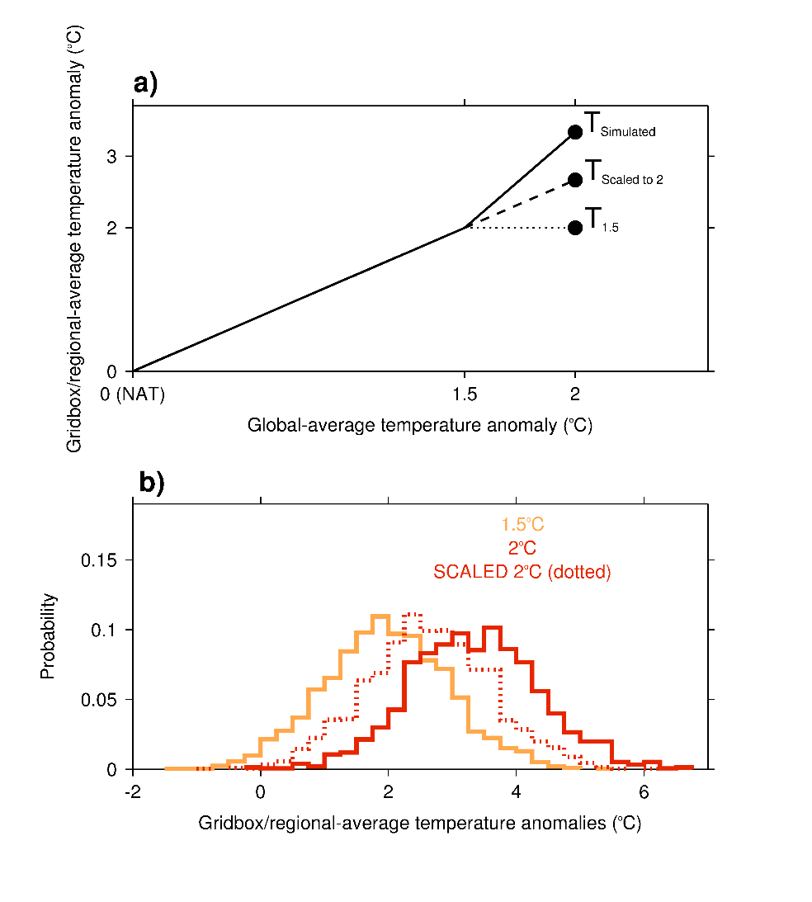
On the linearity of local and regional temperature changes from 1.5°C to 2°C of global warming
Objective: The Paris Agreement has committed to limiting global warming to 1.5°C and 2°C levels above pre-industrial conditions. We use a pattern-scaling approach to investigate the linearity of local temperatures from a 1.5°C world up to a 2°C world
Research: Ensembles of transient coupled climate simulations from multiple models under different scenarios were compared and individual model responses were analysed
--In most regions, the multimodel ensemble average suggests that a linear warming response is likely
--Large contributions from non-linear changes in unforced variability or the forced response cannot be ruled out, particularly in East Asia related to aerosols
Schematics illustrating a) definitions of departures from scaling, and b) the generation of artificial scaled statistical distributions. In the example illustrated here the model median simulated warming is 0.67ºC or 100% above the scaled response.
Impact: Our findings suggest that, where forcings other than those due to greenhouse gas emissions change, the warming experienced in a 1.5°C world is a poor predictor for local climate at 2°C of global warming
King, A.D., R. Knutti, P. Uhe, D. Mitchell, S. Lewis, J.M. Arblaster, N. Freychet, 2018, On the linearity of local and regional temperature changes from 1.5°C to 2°C of global warming, J Climate, https://journals.ametsoc.org/doi/abs/10.1175/JCLI-D-17-0649.1, in press

