Slide 1
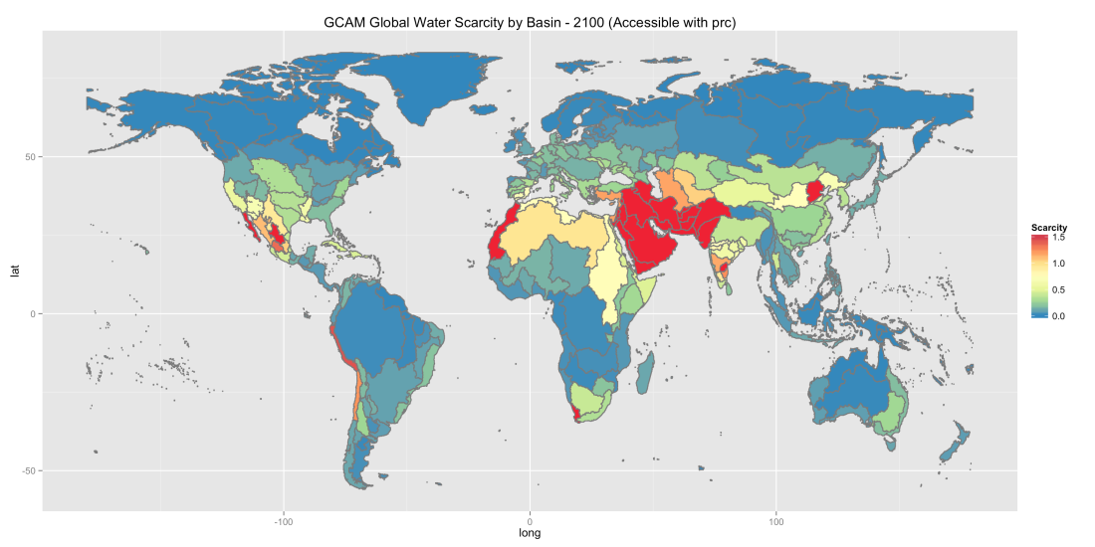
Balancing Global Water Availability and Use at Basin Scale in an Integrated Assessment Model
Objective
Present a new water modeling capability that includes water availability and demand in an internally consistent global agriculture-energy-economic framework for understanding the impact of water scarcity
Approach
Expand PNNL’s GCAM model to include water supply at 235 global river basins and water demands from agriculture, energy, manufacturing, and municipal in an internally consistent water accounting framework
Generate long-term scenarios of water demands that are constrained by water availability under alternative technology, economic, and climate futures
Water scarcity by basin in 2100 generated by PNNL GCAM model that balances the demand for water with available supply.
Impact
Long-term demands for global water use are lower than previous projections
Limitations on freshwater availability alters the long-term demand and pattern of global water use, particularly for agricultural production and trade
In addition to the supply of renewable sources of freshwater, non-renewable groundwater plays an important role in determining the global and regional use of water
Kim S, M Hejazi, L Liu, K Calvin, L Clarke, J Edmonds, P Kyle, P Patel, M Wise, and E Davies. 2016. “Balancing Global Water Availability and Use at Basin Scale in an Integrated Assessment Model.” Climatic Change, accepted. DOI: 10.1007/s10584-016-1604-6
Notes:
http://www.pnl.gov/science/highlights/highlight.asp?groupid=749&id=4293

Slide 2
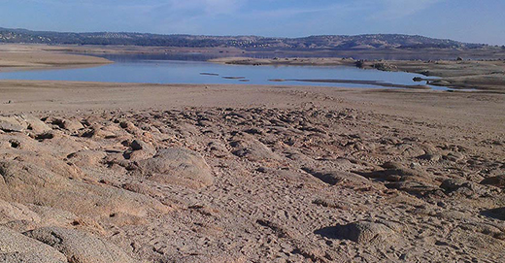
Balancing Global Water Availability and Use at the Basin Scale
Using a unique modeling capability, JGCRI researchers modeled human, resource, and natural water demands and sources, and projected the global demand for water, balanced and limited by water available at major river basin scale, useful at many levels of decision-making. The work reveals that non-renewable groundwater will play a significant role in determining the global and regional use of water.
Reference: Kim SH, M Hejazi, L Liu, K Calvin, L Clarke, J Edmonds, P Kyle, P Patel, M Wise, and E Davies. 2016. "Balancing Global Water Availability and Use at Basin Scale in an Integrated Assessment Model.” Climatic Change 136:217-231. DOI: 10.1007/s10584-016-1604-6
Notes:
http://www.pnl.gov/science/highlights/highlight.asp?groupid=749&id=4293

