Slide 1
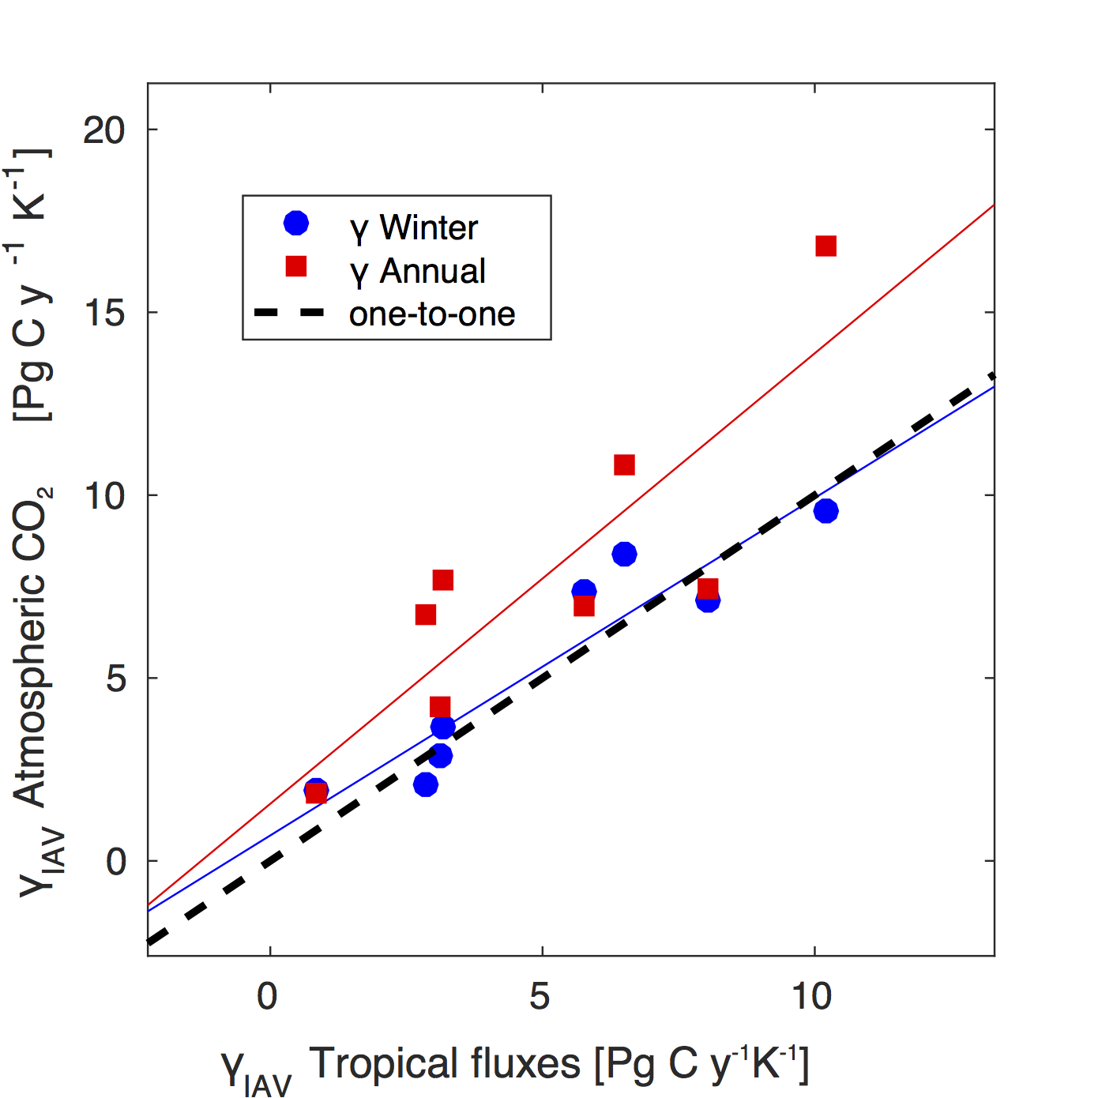
A functional response metric for the temperature sensitivity of tropical ecosystems
Objective: To develop a benchmark for tropical ecosystems using atmospheric CO₂ observations.
Approach: Propogate CMIP5 carbon fluxes through an atmospheric transport model for comparison with atmospheric CO₂ observations.
Results/Impacts: The use of the boreal winter, rather than annual, CO₂ growth rate provides a new functional response metric for the temperature sensitivity of tropical fluxes. When this metric is applied as an emergent constraint for refining the best estimate of the climate vulnerability of tropical ecosystems, the long-term temperature sensitivity is reduced by 20% compared to when an annual diagnostic is used.
Figure: Winter season CO₂ observations isolate the temperature sensitivity of tropical ecosystems.
Keppel-Aleks, Gretchen, Samantha J. Basile, and Forrest M. Hoffman (2018), A functional response metric for the temperature sensitivity of tropical ecosystems, Earth Interact., 22(7):1–20, doi:10.1175/EI-D-17-0017.1.

