Slide 1
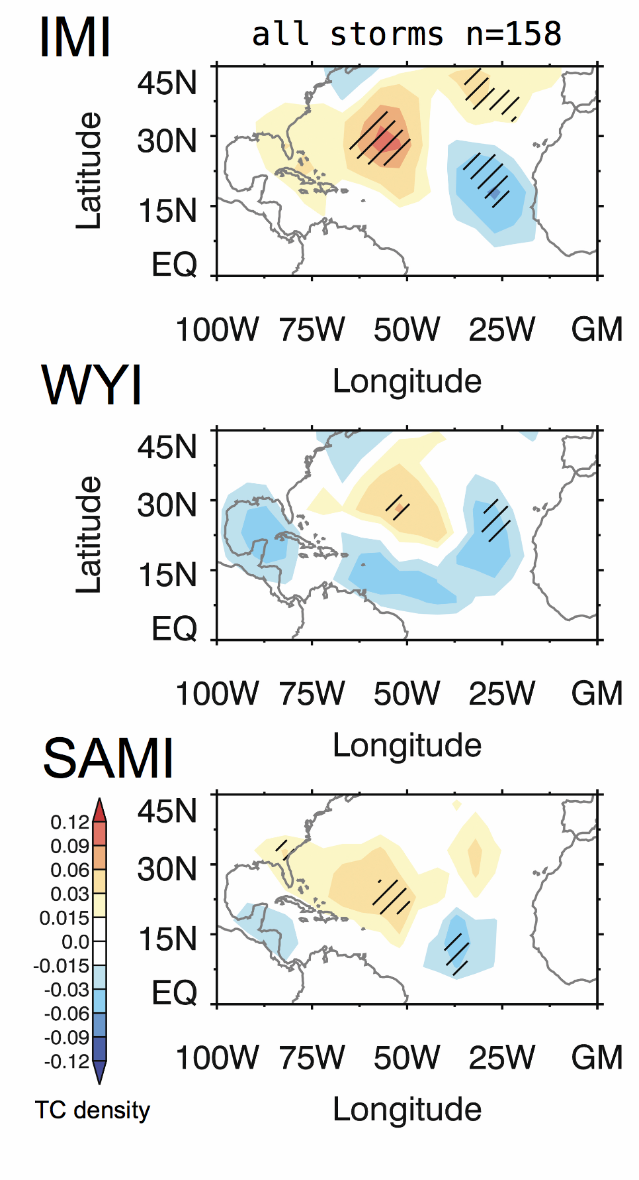
Indian Monsoon Steers Tropical Cyclones
Across the Atlantic
Objective
To better understand what causes historical variations of tropical cyclone (TC) tracks in the North Atlantic basin
Approach
Combine statistical analysis of observational records with a PNNL-developed modeling approach to assess the role of large-scale steering changes on TC tracks
Impact
Identified the Indian monsoon as a constraint governing TC tracks, independent of the El Niño Southern Oscillation (ENSO)
A stronger monsoon implies increased landfall probability (after controlling for other factors)
Variability of the monsoon may serve as a remote source of predictability of Atlantic TCs, now and into the future
Regression composites of historical TC variations on different monsoon indices indicate monsoon-driven steering effects, independent of ENSO’s impact on TC frequency.
Kelly P, LR Leung, K Balaguru, W Xu, B Mapes, and B Soden. 2018. “Shape of Atlantic tropical cyclone tracks and the Indian monsoon,” Geophysical Research Letters, 45. DOI: 10.1029/2018GL080098.

