Slide 1
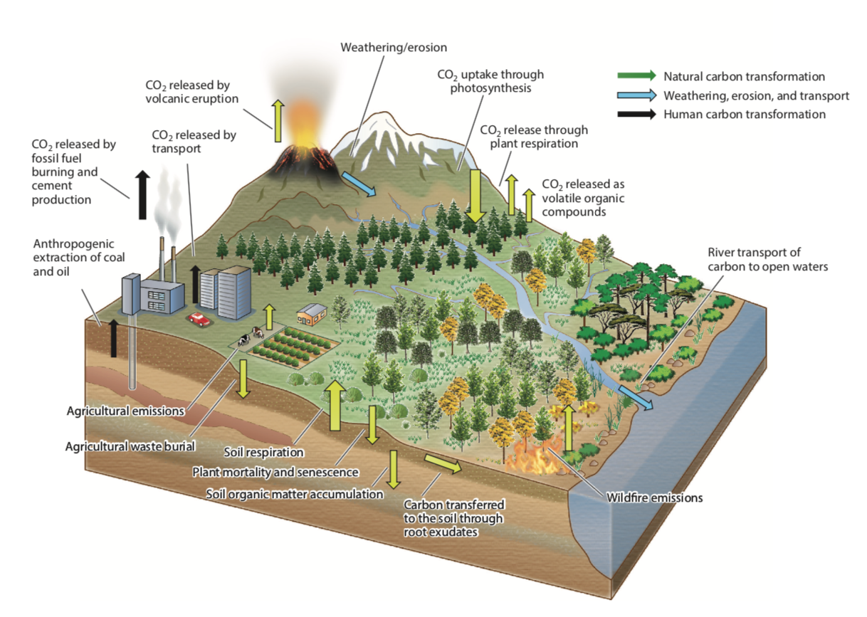
The Terrestrial Carbon Sink
Scientific Achievement
We report large advances in understanding of the processes and key regions that govern the terrestrial carbon sink
Model-data infrastructure in particular is becoming more and more relevant to carbon cycle science
Key unknowns remain however, including the global distribution of the current carbon sink and the sensitivity of governing processes to environmental changes
Figure: The primary flows and exchanges that constitute the terrestrial carbon cycle, including uptake through photosynthesis, release to the atmosphere through both anthropogenic (fossil fuel emissions, biomass burning, land use) and natural emissions (autotrophic and heterotrophic respiration, wildfires, volcanic eruptions), and weathering, erosion, and transport
Significance and Impact
The continuation of the global carbon sink is essential in order to achieve climate mitigation targets
This review highlights key areas when more understanding is needed in order to provide policy-actionable projections of the terrestrial carbon sink under future climates
Research Details
Here we review progress over the past decade in understanding of the terrestrial carbon sink and the tools used to examine it.
Keenan, T.F. & Williams, C. The Terrestrial Carbon Sink. Annual Reviews (in press).

