Slide 1
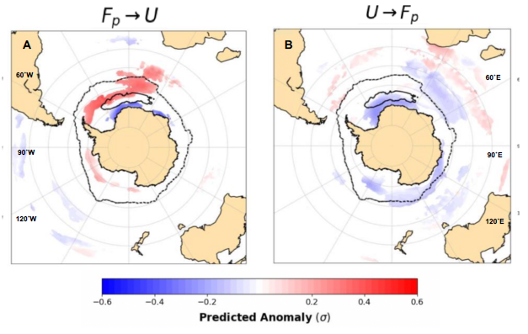
Causal Discovery of Episodic Polynya Heat Loss in the Weddell Sea
Objective
Study causal relationships between ocean/sea ice/atmosphere interactions associated with polynyas in the Southern Ocean.
Impact
We find that polynyas cause meridional heat transport anomalies in the atmosphere and ocean.
The decadal occurrence of Weddell Sea polynyas in this model results from a gradual accumulation of heat during periods of full sea ice cover and a negative phase of the SAM.
A rapid poleward shift of the westerlies then leads to destratification that triggers polynya formation.
This study helps us understand the impacts of
the Weddell Sea polynyas in the mid-70s;
a potential reappearance of the Weddell Sea polynya in the future;
polynyas on biases in climate models.
Research
We study Weddell Sea polynyas in the high-resolution climate model E3SMv0-HR.
We use Granger causality to explore the relationships between Weddell Sea polynyas and the high-latitude energy budget.
Granger causality between heat loss in the polynya mask region (F_{p}) and zonal winds (U). Left panel shows that polynya heat loss ‘Granger causes’ a strengthening of the westerlies (red) and coastal easterlies (blue). Right panel shows that a weakening (northward shift) of the westerlies precedes polynya formation.
Z. S. Kaufman, N. Feldl, W. Weijer, M. Veneziani, 2020: Causal Interactions Between Southern Ocean Polynyas and High-Latitude Atmosphere-Ocean Variability. Journal of Climate, 33, 4891-4905. https://doi.org/10.1175/JCLI-D-19-0525.1.

