Slide 1
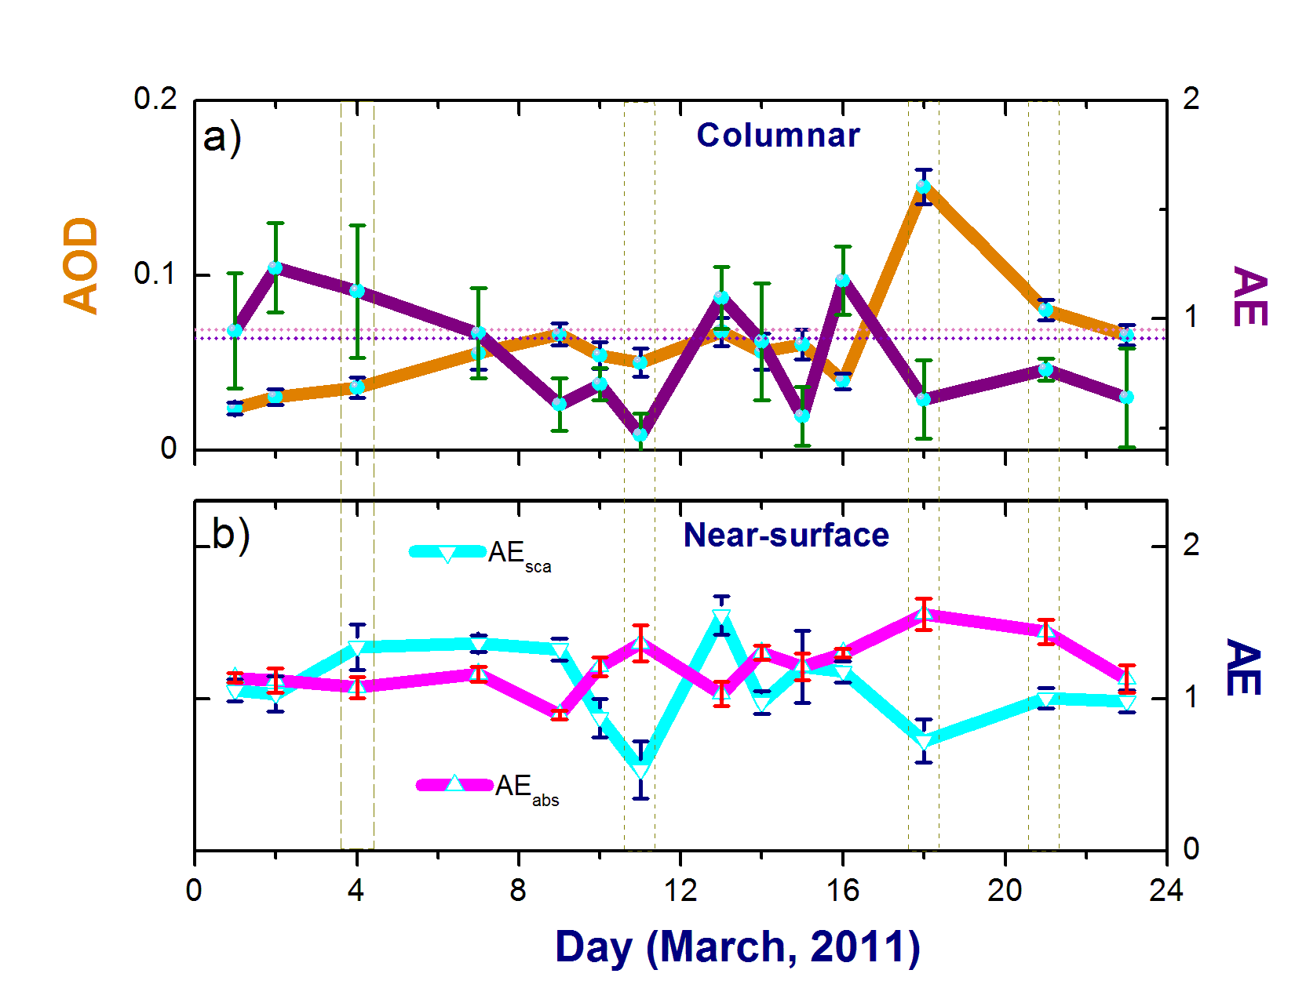
Gone with the Wind: The Trans-Pacific Journey of Atmospheric Particles
Objective
Examine evolution of Asian and African dust particles during their trans-Pacific transport to the Rocky Mountains using combined analysis of Atmospheric Radiation Measurement (ARM) Climate Research Facility and NASA data, and quasi-global simulations
Approach
Analyze ARM Mobile Facility (AMF) data to identify a major dust event at high-elevation sites in Colorado
Characterize this event using simulations of dust evolution from climate models and NASA data
Estimate the contribution of transported dust to observed aerosol properties at the high altitude of the Rocky Mountains
Developed framework links ARM and NASA observations with simulations over various spatial scales
Impact
Findings show dust particles might remain suspended in the atmosphere longer and travel over remarkably longer distances than anticipated
The developed framework, with strongly linked observational and modeling components, has the potential to estimate uncertainties of climate model predictions
Kassianov E, M Pekour, C Flynn, LK Berg, J Beranek, A Zelenyuk, C Zhao, LR Leung, P-L Ma, L Riihimaki, JD Fast, J Barnard, AG Hallar, IB McCubbin, EW Eloranta, A McComiskey, and PJ Rasch. 2017. “Large Contribution of Coarse Mode to Aerosol Microphysical and Optical Properties: Evidence from Ground-Based Observations of a Trans-Pacific Dust Outbreak at a High-Elevation North American Site.” Journal of the Atmospheric Sciences, early online. DOI: 10.1175/JAS-D-16-0256.1
Notes:
http://www.pnnl.gov/science/highlights/highlights.asp?division=749

