Slide 1
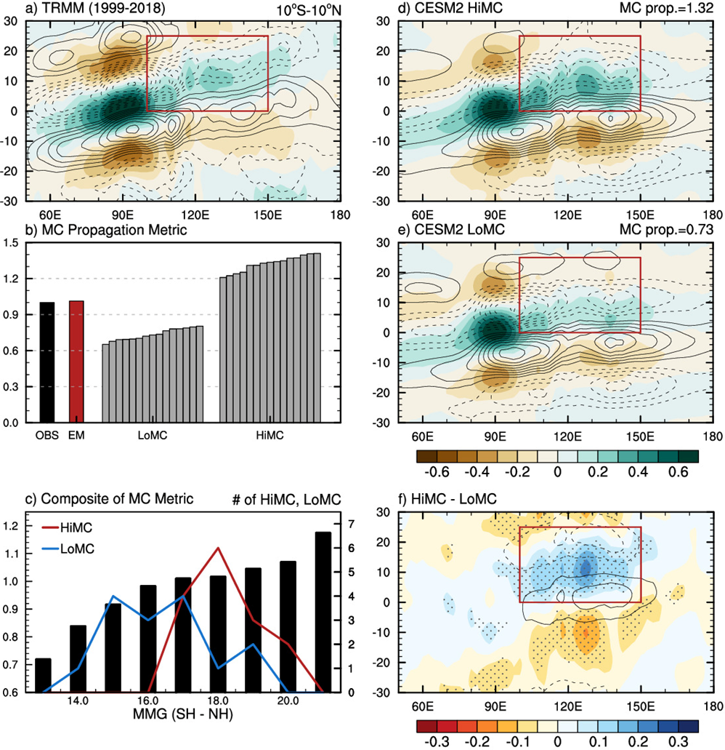
Role of the mean state moisture gradient on the propagation of the MJO across the Maritime Continent
Kang, D., D. Kim, M.-S. Ahn, R. Neale, J.-W. Lee, and P. Glecker, 2020: The role of the mean state on MJO simulation in CESM2 ensemble simulation. Geophy. Res. Lett., 47, e2020GL089824. https://doi.org/10.1029/2020GL089824
Objective
To assess the effect of the mean state on Madden-Julian Oscillation (MJO) propagation across the Maritime Continent (MC) that is unaffected by that of model components such as parameterization schemes
Approach
Use an ensemble of simulations made with a single model - the Community Earth System Model version 2 (CESM2)
Compare mean state differences between epochs with stronger (HiMC) and weaker (LoMC) MJO variability in the MC region
Impact
Our result demonstrate that changes in the mean state moisture gradient associated with low-frequency variability could lead to substantial changes to MJO propagation characteristics
Figure (a) Longitude-time evolution of 20-100 day bandpass-filtered TRMM precipitation (shaded; the unit is mm day⁻¹) and ERA5 column-integrated moisture tendency (contour; kg m⁻² s⁻¹) near the equator (10°S–10°N) regressed onto the precipitation averaged in the IO base point (85–95°E, 5°S–5°N) for 1999-2018. (b) The MC propagation metric for TRMM (black), the ensemble mean of the CESM2 historical simulation (red), and each 20-year moving windows in HiMC and LoMC in ascending order (gray). (c) Composite of the MC propagation metric binned by MMG index in the 1450 windows (bars, left Y-axis), and the number of HiMC and LoMC windows in each bin (lines, right Y-axis). (d-f) Same as (a), but for composites of (d) the HiMC, (e) the LoMC epochs in the historical simulation, and (f) the difference between HiMC and LoMC. Areas with black dots in (f) indicate a statistically significant difference between HiMC and LoMC (p value = 0.01).

