Slide 1
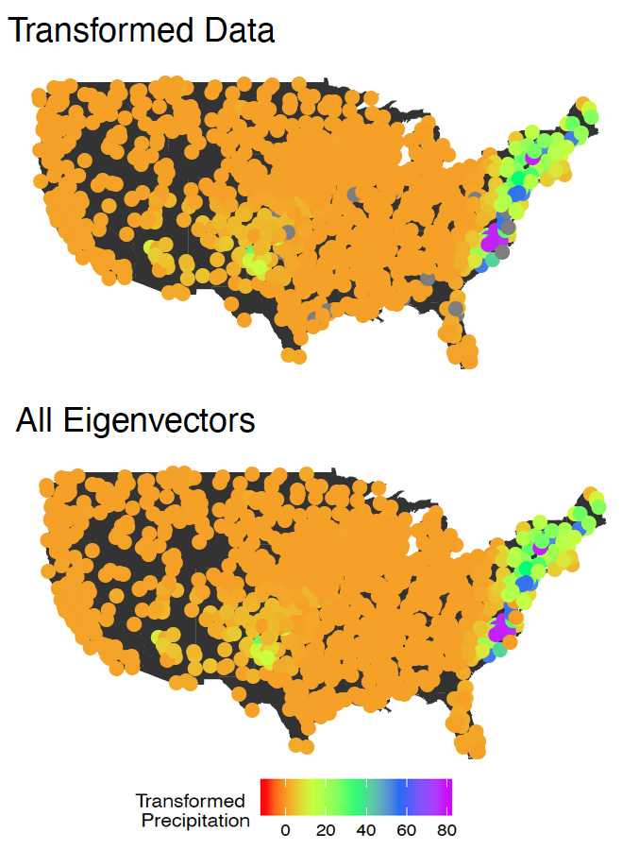
Principal Component Analysis for Extremes and Application to US Precipitation
We propose a method for analyzing extremal behavior through the lens of a most-efficient basis of vectors. The method is analogous to principal component analysis, but is based on methods from extreme value analysis. Specifically, rather than decomposing a covariance or correlation matrix, we obtain our basis vectors by performing an eigen decomposition of a matrix which describes pairwise extremal dependence.
The standard eigenfunctions used for Principal Component Analysis (PCA) analyses are not applicable for application to the tails of distributions. Our new statistical method presents a new set of eigenfunctions tailored to extreme values. We demonstrate that these functions have the same properties as standard EOFs and can reconstruct the variability of extreme precipitation. This opens up possibilities to develop rigorous detection and attribution methods for extreme temperature and precipitation as well as explore the effect of natural modes of variability.
Representations of the data for September 16, 1999, the date corresponding to Hurricane Floyd. Shown are a plot of the transformed data, a complete basis reconstruction
Y., Jiang, D. Cooley, M.F. Wehner (2020) Principal Component Analysis for Extremes and Application to US Precipitation. To appear in Journal of Climate.
A new mathematical formalism, tailored to extreme values, is developed to permit eigenfunction analyses of extreme temperature and precipitation analogous to Principal Component Analyses of means.

