Slide 1
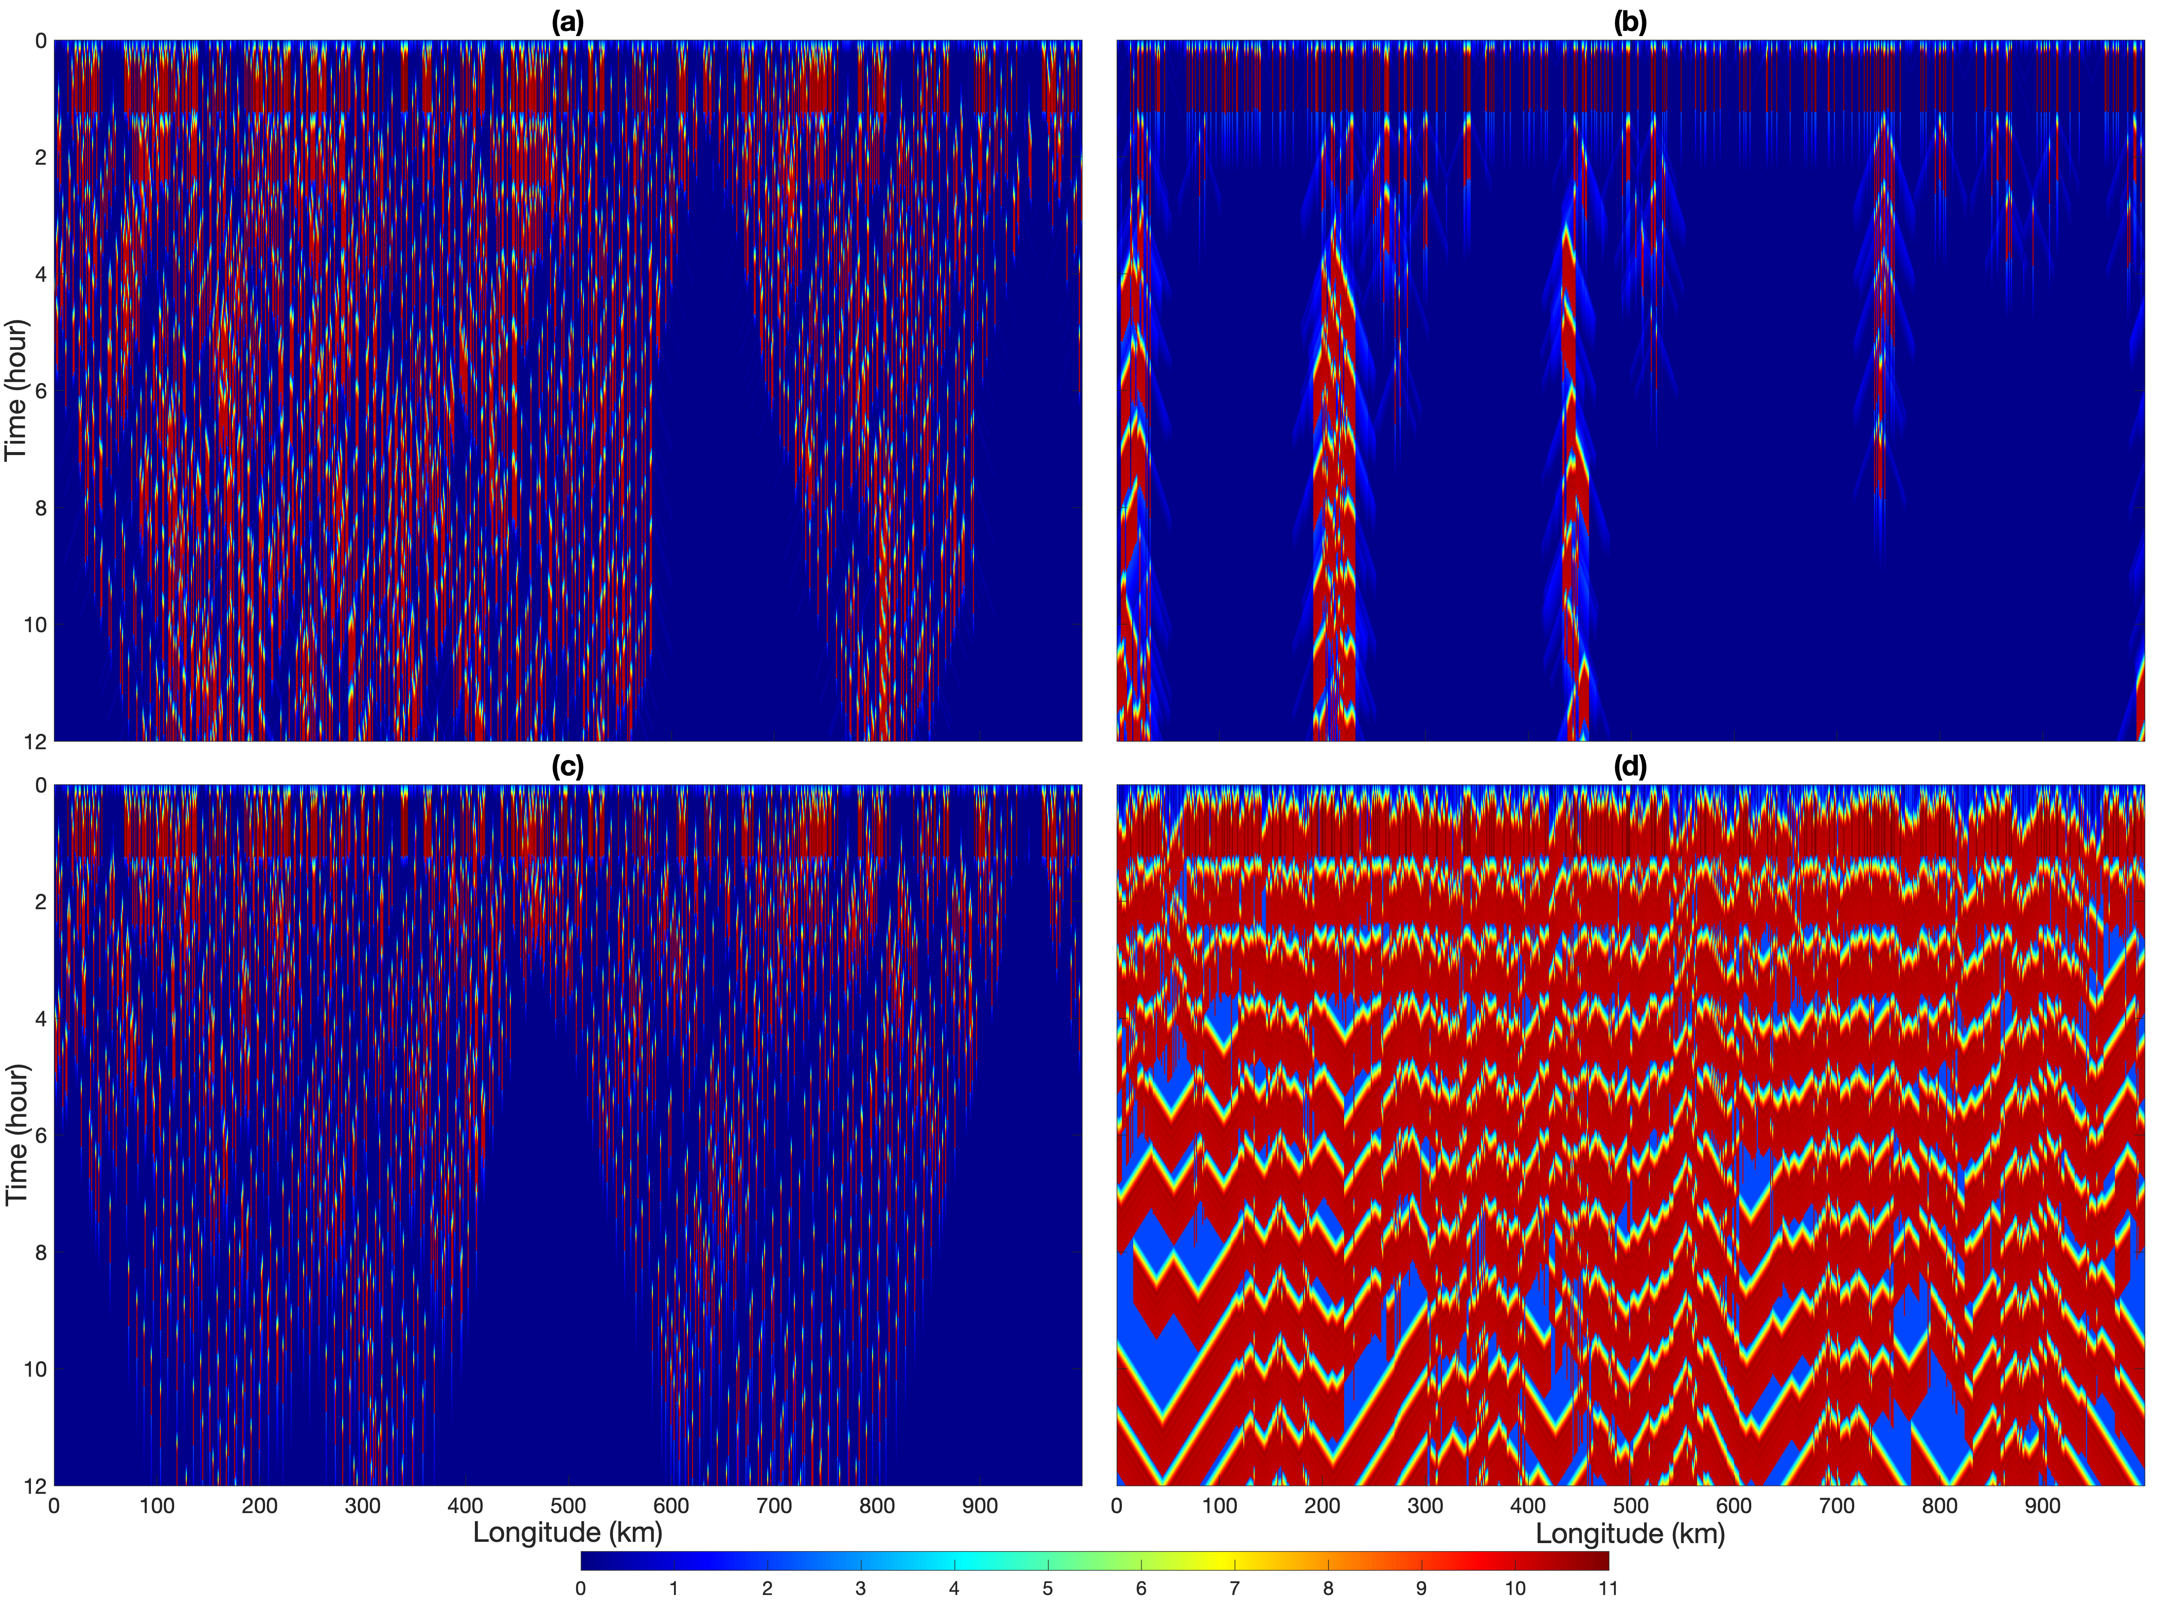
Edited
Building a Theoretical Model for Thunderstorms over the Central United States
Objective
Build a simple Lagrangian parcel model for understanding the initiation of summer-time mesoscale convective systems (MCSs) that produce heavy precipitation over the central United States.
Approach
Develop single- and multi-column models to simulate the basic features of a rising parcel and idealized cold pool interaction mechanisms.
Use observed climatological mean environments as background profiles to initiate model simulations and compare them to both observations and cloud-resolving simulations.
Impact
The single-column model demonstrates the collective effects of boundary layer moistening and dynamical lifting in triggering convective initiation and simulates the impact of global warming on convective initiation.
The multi-column model captures the cold pool induced upscale growth feature in MCS genesis, from initially scattered convection to organized mesoscale cluster.
This simple model should be useful for understanding the fundamental mechanisms of MCS initiation and constraining climate model projections of future MCS changes.
The multi-column parcel model with cool pool interaction mechanisms (top) can simulate organized convection within a few hours after isolated convection was triggered randomly at hour 0 (bottom), suggesting that cool pool mechanisms play a key role in the development of MCSs.
Yang, Q., Leung, L. R., Feng, Z., Song, F., & Chen, X. A Simple Lagrangian Parcel Model for the Initiation of Summer-time Mesoscale Convective Systems over the Central United States. Journal of the Atmospheric Sciences, (2021). [DOI: https://doi.org/10.1175/JAS-D-21-0136.1]

Slide 2
Original
Building a Theoretical Model for Thunderstorms over the Central U.S.
Objective
To build a simple Lagrangian parcel model for understanding the initiation of summer-time mesoscale convective systems (MCSs), complex of thunderstorms that produce heavy precipitation over the central United States.
Approach
Develop a single-column model and a multi-column model to simulate the basic features of a rising parcel and the idealized cold pool interaction mechanisms.
Use the observed climatological mean environments as the background profiles to initiate model simulations and compare them to observations and cloud-resolving simulations.
Impact
The single-column model demonstrates the collective effects of boundary layer moistening and dynamical lifting in triggering convective initiation and the impact of global warming.
The multi-column model captures readily the cold pool induced upscale growth feature in MCS genesis from initially scattered convection to organized mesoscale cluster in a few hours.
This simple model should be useful for understanding the fundamental mechanisms of MCS initiation and constraining climate model projections of future changes in MCSs.
Top: The single-column parcel model (left) and the multi-column model with cool pool interaction mechanisms. Bottom: The multi-column model simulated the organization of scattered convection to organized mesoscale clusters within a few hours.
Yang, Q., Leung, L. R., Feng, Z., Song, F., & Chen, X. (2021). A Simple Lagrangian Parcel Model for the Initiation of Summer-time Mesoscale Convective Systems over the Central United States. Journal of the Atmospheric Sciences. DOI: https://doi.org/10.1175/JAS-D-21-0136.1

